Slide 1
ACNS Critical Care EEG Terminology Training Module 2021
Markus Leitinger, MD
Department of Neurology, Christian Doppler University Hospital
Center for Cognitive Neuroscience
Paracelsus Medical University
Salzburg, Austria
Michael W.K. Fong, MBBS
Westmead Comprehensive Epilepsy Unit
Westmead Hospital
University of Sydney
Sydney, Australia
Lawrence J. Hirsch, MD
Comprehensive Epilepsy Center
Department of Neurology
Yale University School of Medicine,
New Haven, CT, USA

Slide 2
Mode of presentation
General remarks:
This module has been designed to provide a self guided introduction to the important components of the ACNS standardized critical care EEG terminology, 2021 version. It focuses on discussing terms that are commonly used or with a high clinical importance. It does not describe all of the major and minor modifiers (although it includes many). For comprehensive details on all feaures of the terminology please refer to the ACNS guideline that can be found at https://www.acns.org/practice/guidelines, under “Continuous EEG Monitoring in Critical Care“, or via the Journal of Clinical Neurophysiology https://journals.lww.com/clinicalneurophys/Fulltext/2021/01000/American_Clinical_Neurophysiology_Society_s.1.aspx

Slide 3
Contents
Sequence of topics (follows the full guideline):
A. EEG BACKGROUND
B. SPORADIC EPILEPTIFORM DISCHARGES
C. RHYTHMIC AND PERIODIC PATTERNS (RPPs)
D. ELECTROGRAPHIC AND ELECTROCLINICAL SEIZURES [NEW, 2021]
E. BRIEF POTENTIALLY ICTAL RHYTHMIC DISCHARGES (BIRDs) [NEW, 2021]
F. ICTAL-INTERICTAL CONTINUUM (IIC) [NEW, 2021]
Sequence of slides for each topic:
1. Introductory text plus diagram
2. EEG example alone with question at the bottom
3. EEG with explanatory annotations
4. Summary slide

Slide 4
A. EEG Background

Slide 5
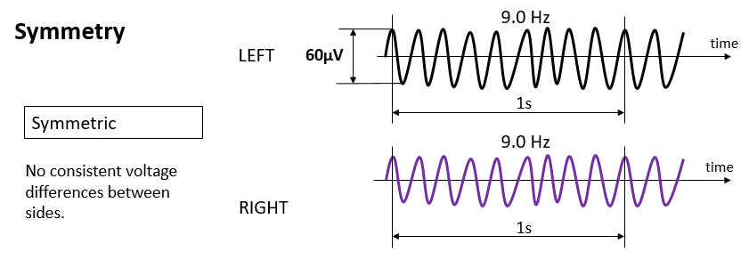
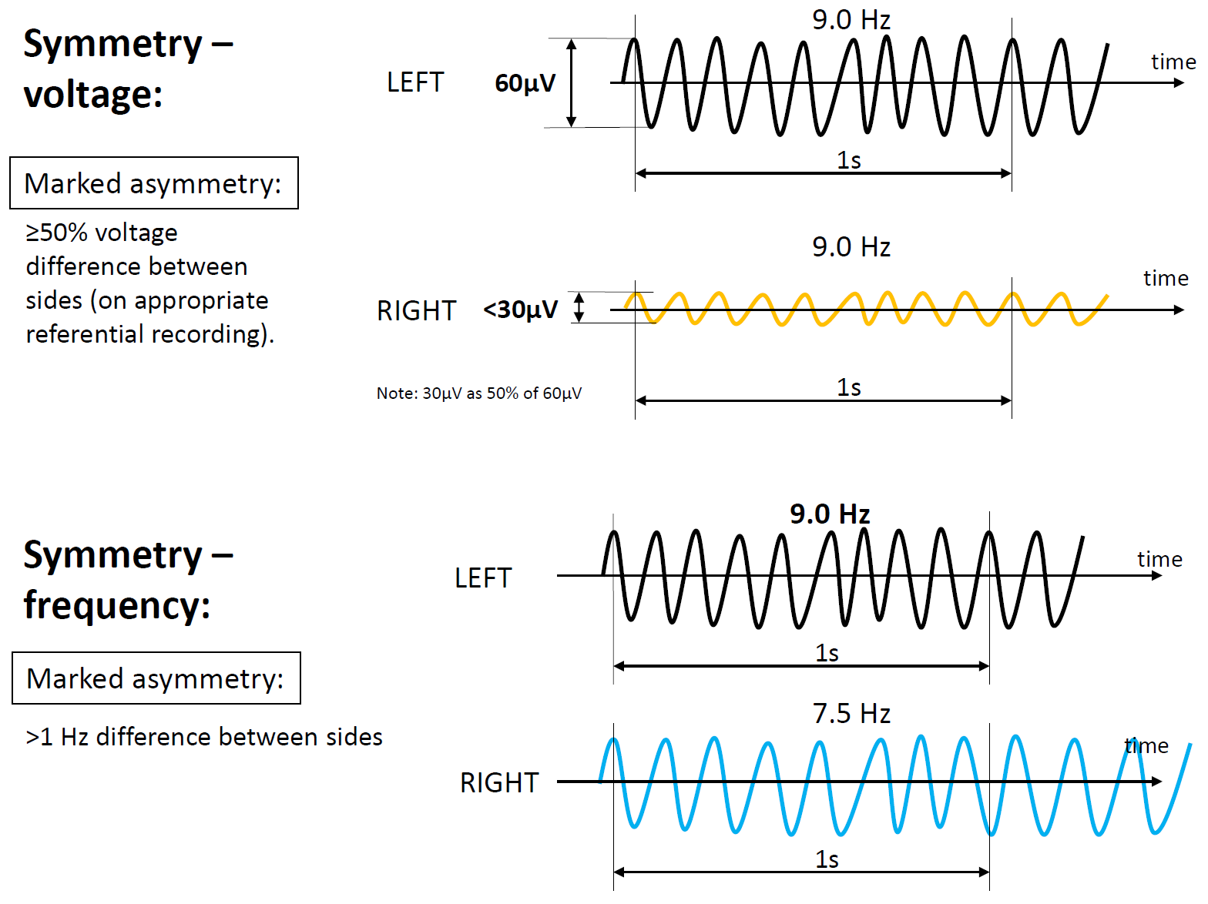
EEG BACKGROUND
1. Symmetry
a. Symmetric.
b. Mild asymmetry (consistent asymmetry in voltage on an appropriate referential recording of <50% or consistent asymmetry in frequency of 0.5 to 1 Hz).
c. Marked asymmetry (≥50% voltage or >1 Hz frequency asymmetry).
2. Predominant Background Frequency When Most Awake or After Stimulation: Beta (>13 Hz), Alpha, Theta, Delta.
NOTE: If two or three frequency bands are equally prominent, report each one.
3. Posterior Dominant (“Alpha”) Rhythm (must be demonstrated to attenuate with eye opening; wait >1 second after eye closure to determine frequency
to avoid “alpha squeak”): Present: Specify frequency to the nearest 0.5 Hz, Absent, Unclear.
No consistent voltage differences between sides.

Slide 6
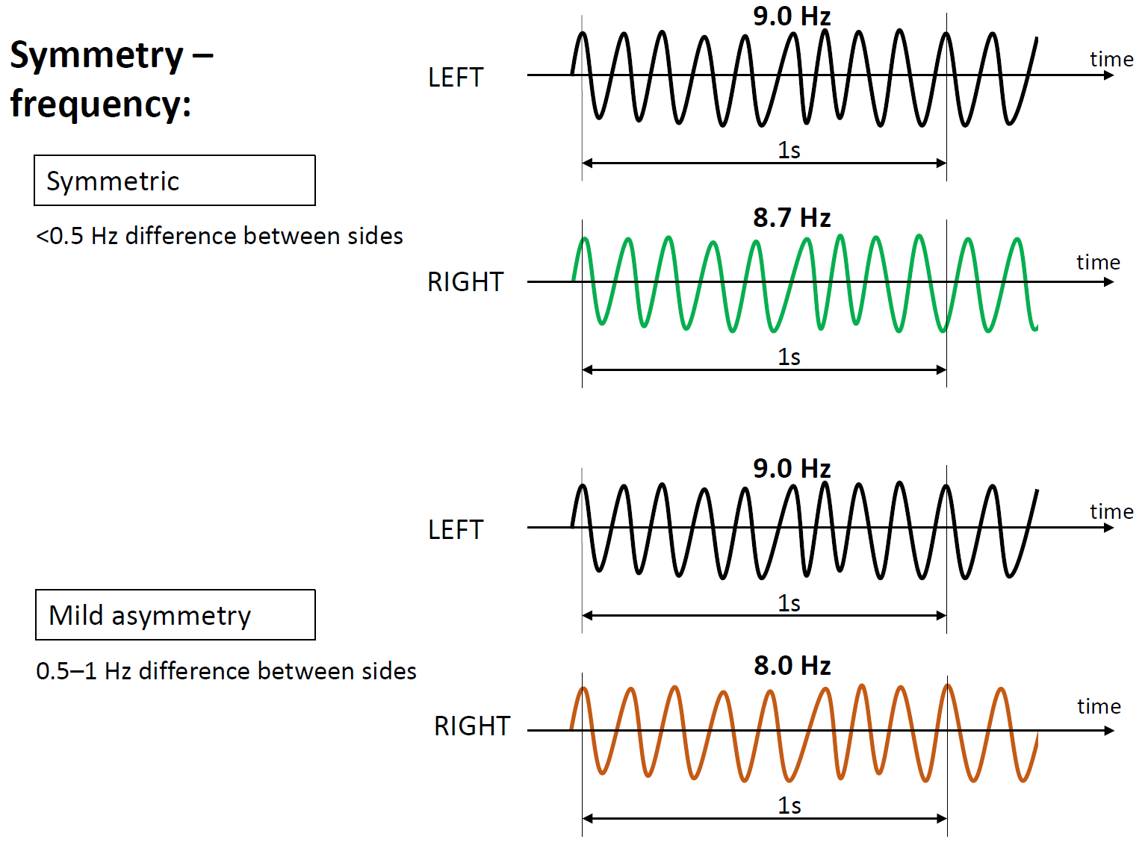
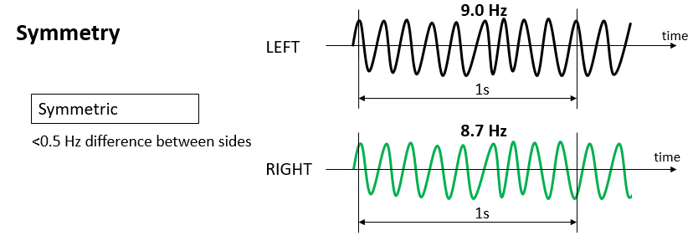
EEG BACKGROUND
No consistent frequency differences between sides.

Slide 7
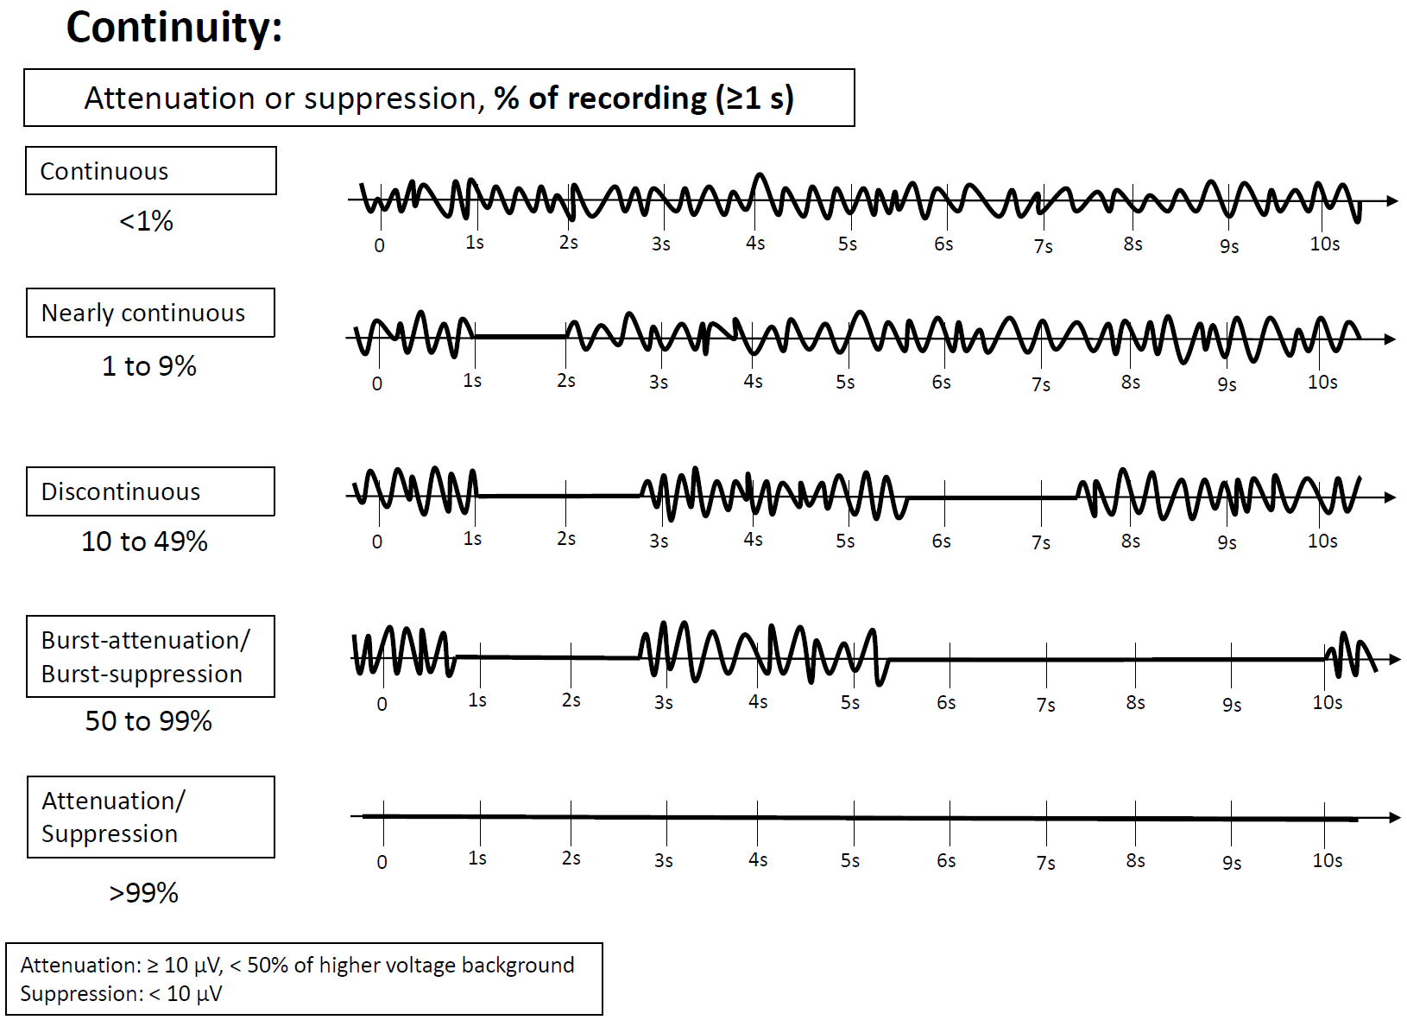
EEG BACKGROUND
4. Continuity
a. Continuous
b. Nearly Continuous: continuous, but with occasional (1–9% of the record) periods of attenuation or suppression lasting ≥1 second.
c. Discontinuous: A pattern of attenuation/suppression alternating with higher voltage activity, with 10% to 49% of the record consisting
of attenuation or suppression.
d. Burst attenuation/Burst suppression: A pattern of attenuation/suppression alternating with higher voltage activity, with 50% to 99% of
the record consisting of attenuation
e. Suppression/attenuation: entirety or near-entirety (>99%) of the record consists of either suppression (all <10 µV, as defined above) or
low voltage activity (all <20 µV but not qualifying as suppression). Specify whether attenuated or suppressed.

Slide 8
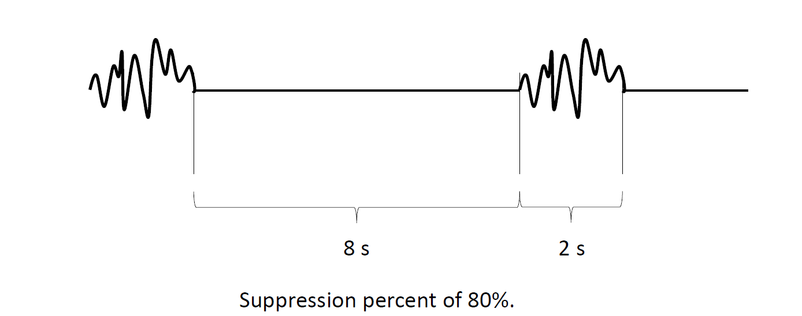
EEG BACKGROUND
Attenuation percent or Suppression percent: the percent of the record/epoch that is attenuated or suppressed. This can range from 1% to 99%. If <1%, it is considered continuous. If >99%, it is considered either suppressed or attenuated, but not discontinuous. For example, a record with 2 second bursts alternating with 8 seconds of suppression, as shown here, would be Burst-Suppression with a suppression percent of 80%.

Slide 9
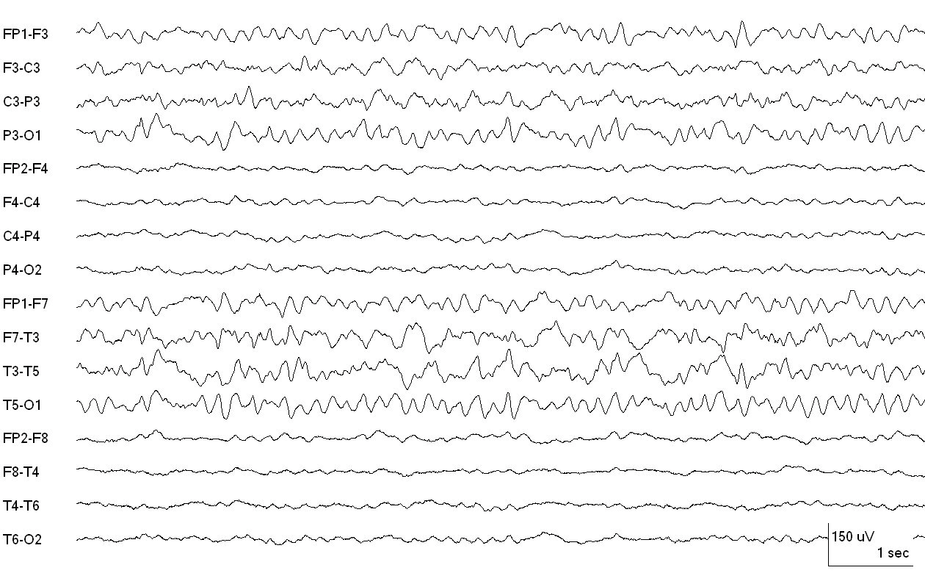
How is the background of this EEG best described?
(attempt to answer as best as possible before progressing to the explanation on the next slide)
Reproduced with permission from Hirsch LJ, Fong MWK, Brenner RP. Atlas of EEG in Critical Care, second edition, Wiley: 2022

Slide 10
LEFT 80 µV
ASYMMETRY in VOLTAGE:
MILD: < 50% less on one side
MARKED: ≥ 50% lower voltage
RIGHT 30 µV
CONTINUOUS POLYMORPHIC DELTA ACTIVITY OVER LEFT MID-TEMPORAL (NOT RHYTHMIC)
Continuous EEG with voltage asymmetry (marked, lower on right) and slowing on the left, polymorphic delta.
Reproduced with permission from Hirsch LJ, Fong MWK, Brenner RP. Atlas of EEG in Critical Care, second edition, Wiley: 2022

Slide 11
How is the background of this EEG best described?
Reproduced with permission from Hirsch LJ, Fong MWK, Brenner RP. Atlas of EEG in Critical Care, second edition, Wiley: 2022

Slide 12
Continuous EEG with frequency asymmetry, marked (beta on right and theta with polymorphic delta slowing [boxes] on left)
Reproduced with permission from Hirsch LJ, Fong MWK, Brenner RP. Atlas of EEG in Critical Care, second edition, Wiley: 2022

Slide 13
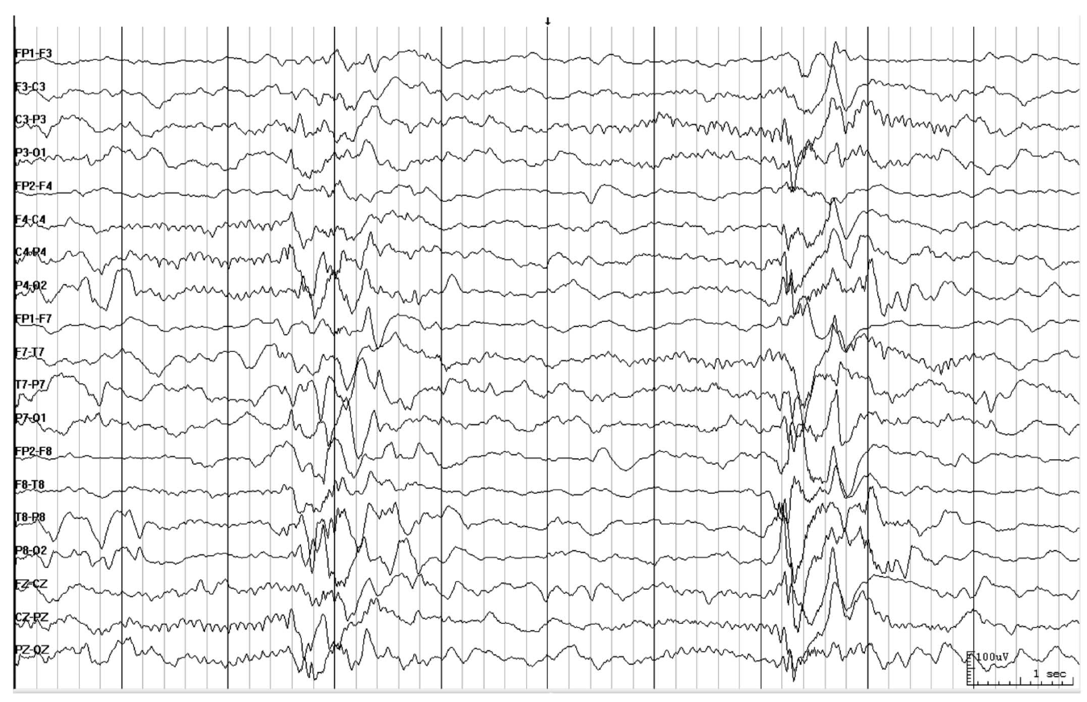
How would you describe this EEG?

Slide 14
Burst-attenuation pattern: Bursts (>0.5 sec AND >3 phases) of generalized activity; inbetween bursts there is lower amplitude activity (<50% of the higher amplitude portion/ bursts, but ≥10 µV i.e., attenuation, not suppression).
Higher voltage activity qualifies as bursts: ≥0.5s AND ≥ 4 phases
about 10 phases
ATTENUATION (amplit. ≥10 µV): 2.5 s
BURST: 1.5 s
ATTENUATION: 3 s
BURST: 1 s
A: 2 s
Burst-attenuation pattern
Bursts: generalized. Attenuation percent = 7.5s/10s = 75% (i.e., between 50-99%, qualifying as burst suppression/attenuation)

Slide 15
LOWER VOLTAGE PORTION ~50 µV
BURST ~ 200 µV
Interburst EEG is attenuated not suppressed
ATTENUATION: < 50% of higher voltage portion/ bursts, but ≥ 10 µV (activity <10 µV would qualify as suppressed). Therefore this is burst attenuation, rather than burst suppression.

Slide 16
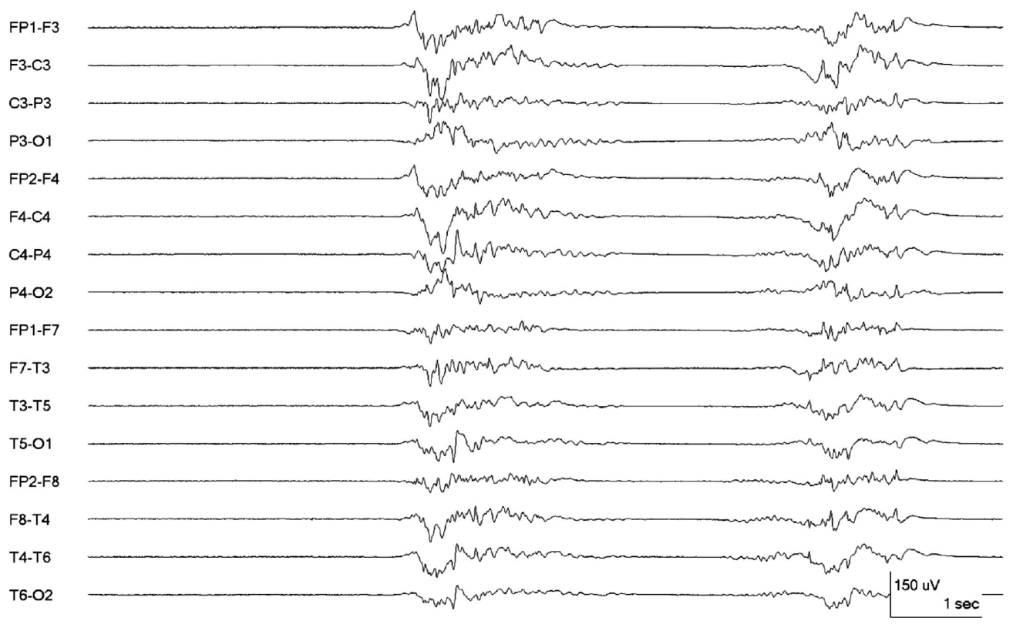
How would you describe this EEG?

Slide 17
about 20 phases (only larger ones colored)
2.5 s
BURST: ≥0.5 s AND ≥ 4 phases
SUPPRESSION (amplitude <10 µV): 3.5 s
BURST: 2 s
SUPPRESSION: 2 s
BURST: 2 s
S: 0.5 s
Burst suppression pattern,
Suppression percent = 6s/10s = 60%. Compared to the prior example the inter-burst EEG is now suppressed (i.e., now qualifies as burst suppression).

Slide 18
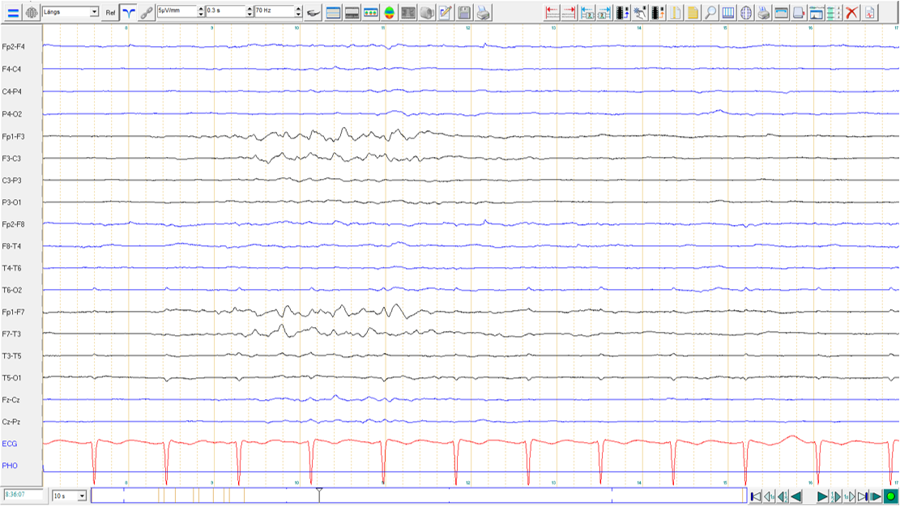
5 µV/mm
How would you describe this page of EEG?

Slide 19
RIGHT: SUPPRESSION
5 µV/mm
SUPPRESSION
LEFT: BURST
SUPPRESSION
Lateralized burst suppression on the left.
Only 1 burst is shown here with a suppression percent of 75% (7.5 out of 10 sec). It is lateralized because the pattern is only present in one hemisphere.
Suppression on the right.
If the background activity differs significantly between hemispheres it is worth characterizing for both. In this case there is suppression on the right; however, lateralized burst suppression could occur with the contralateral hemisphere containing more physiologic rhythms (i.e., nearly continuous or continuous).

Slide 20
HIGHLY EPILEPTIFORM BURSTS
Two or more epileptiform discharges (spikes or sharp waves),
within the majority (>50%) of bursts, and
occur at an average of 1 Hz or faster within a single burst
OR…

Slide 21
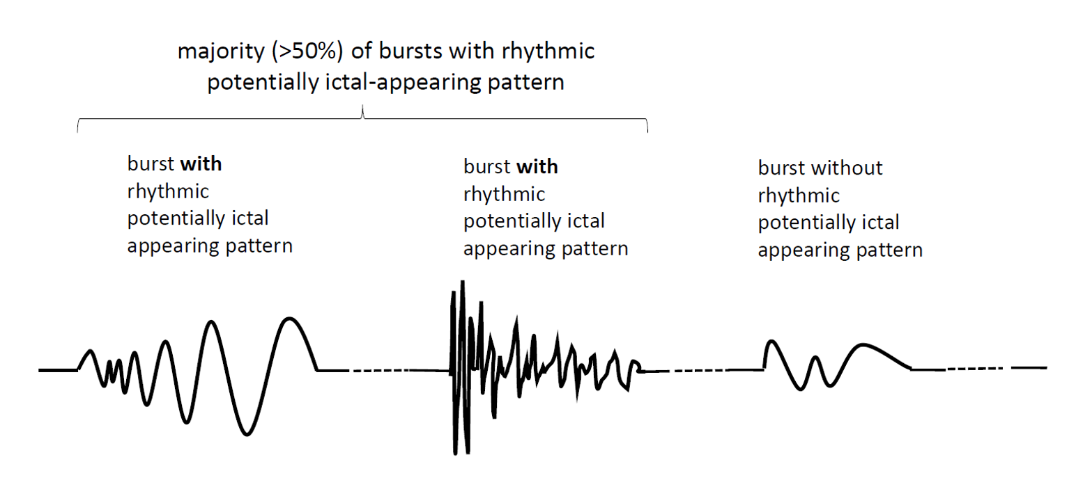
HIGHLY EPILEPTIFORM BURSTS

Slide 22
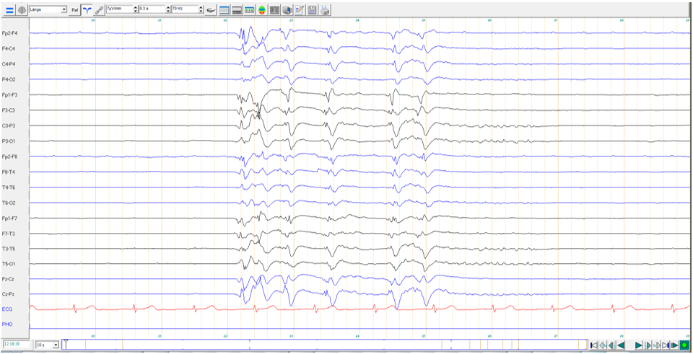
How can the continuity and the activity be best described?

Slide 23
HIGHLY EPILEPTIFORM BURSTS:
2 or more epileptiform discharges (spikes or sharp waves) occur
within the majority (>50%) of bursts and occur at an average of 1 Hz or faster
within a single burst: 6 EDs/4.5s= > 1 Hz
= Epileptiform discharge
SUPPRESSION (amplitude <10 µV): 3 s
BURST: 4.5 s
SUPPRESSION: 2.5 s
Burst suppression with Highly-Epileptiform Bursts (HEBs)
Only 1 burst shown, suppression percent = 5.5s/10s = 55%, i.e., qualifies as burst suppression
Each burst contains 2 or more epileptiform discharges that occured within the majority of bursts (not shown). Bursts therefore qualify as “highly-epileptiform“.
Burst suppression pattern, Suppression percent = 5.5s/10s = 55%; Highly epileptiform burst

Slide 24
IDENTICAL BURSTS
Present if the first 0.5 s or longer of each burst is visually similar in all channels in the vast majority (>90%) of bursts.
Largely based on Hofmeijer J, et al. Burst-suppression with identical bursts: a distinct EEG pattern with poor outcome in postanoxic coma. Clin Neurophysiol. 2014 May;125(5):947-54.
OR…

Slide 25
IDENTICAL BURSTS in a STEREOTYPED CLUSTER
If the first 0.5 s or longer of each of two or more bursts in a stereotyped cluster are visually similar in all channels in the vast majority (>90%) of bursts

Slide 26
How would you describe this pattern?

Slide 27
IDENTICAL BURSTS: the first ≥0.5 s
visually similar in all channels
in vast majority (>90%) of bursts
SUPPRESSION (ampl <10 µV): 3 s
BURST
SUPPRESSION: 5s
BURST
SUPPRESSION: 2.5s
Burst suppression with Identical Highly-Epileptiform Bursts (HEBs)
Burst suppression pattern with bursts qualifying as identical AND highly epileptiform. The first 0.5 s of each burst (boxes) is visually similar. NOTE the final half second of the bursts (after the boxes) is not identical; however, these still qualify as identical bursts. The bursts contain >2 epileptiform discharges and are hence also highly epileptiform.

Slide 28
BACKGROUND: REACTIVITY
Definition: Reactivity: Change in cerebral EEG activity to stimulation
Any change in voltage or frequency of cerebral activity counts, including diffuse attenuation.
Appearance of muscle activity does not qualify as reactive.
Categories: Reactive, Unreactive, SIRPIDs-only, Unclear, or Unknown
For unreactive: It is suggested that if an EEG is “unreactive” after one round of stimulation, a second round of standardized noxious stimulation should be performed to confirm the finding and should be applied with the patient in their nonstimulated state. If “unreactive” and the patient is on sedatives or paralytics, we suggest including this important caveat in the impression.
If the only form of reactivity is stimulus-induced rhythmic, periodic, or ictal-appearing discharges (SIRPIDs), categorize as “SIRPIDs-only”. Includes SI-PDs , SI-RDA, SI-SW, SI-seizures, SI-bursts, SI-IIC, or SI-BIRDs.

Slide 29
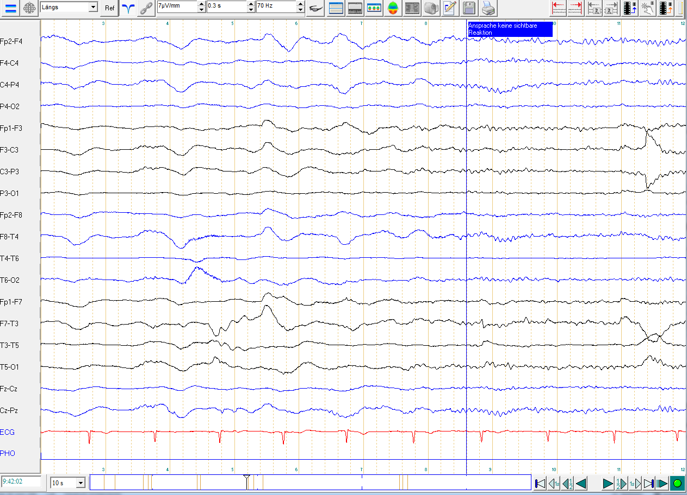
BACKGROUND: REACTIVITY
Test of responsiveness to verbal stimuli
Is the EEG reactive to the verbal stimuli?

Slide 30
BACKGROUND: REACTIVITY
Test of responsiveness to verbal stimuli
Indeed, the EEG is reactive (attenuation of medium voltage polymorphic delta activity, replaced by low voltage beta activity).

Slide 31
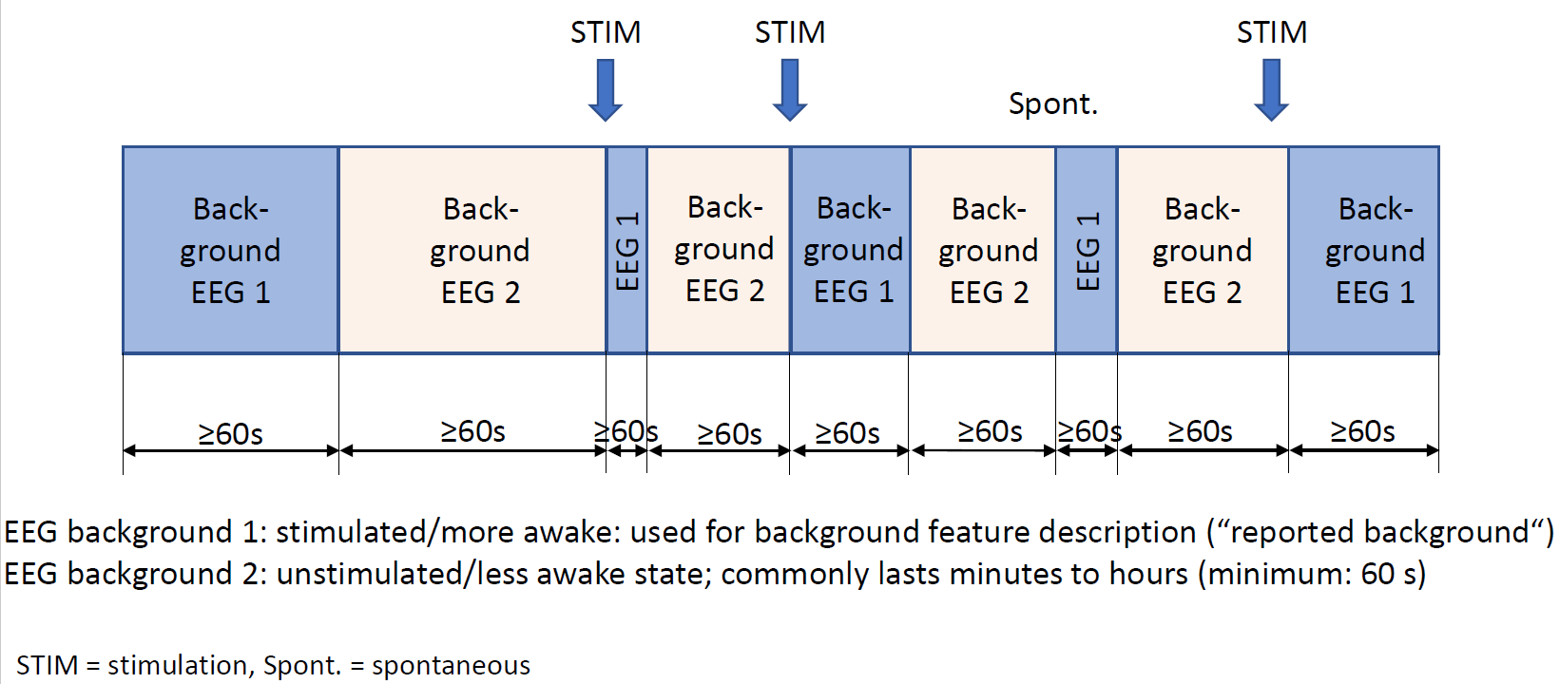
BACKGROUND: STATE CHANGES
Requirements to qualify as having state changes:
At least 2 sustained types of background EEG:
Related to level of alertness or stimulation.
Each must persist at ≥60 s to qualify as a “state“.
Stimulation should be able to transition the patient from the less alert to more alert/more stimulated state.
The more alert/more stimulated state is considered the “reported background“ EEG.
State changes can also occur spontaneously.
Categories of state changes:
a. Present with normal stage N2 sleep transients (K-complexes
and spindles)
b. Present but with abnormal stage N2 sleep transients
Describe both K complexes and spindles separately
as the following:
i. Present and normal.
ii. Present but abnormal. Specify abnormality
(e.g., asymmetry, location, frequency, poorly formed).
iii. Absent.
c. Present but without stage N2 sleep transients.
d. Absent

Slide 32
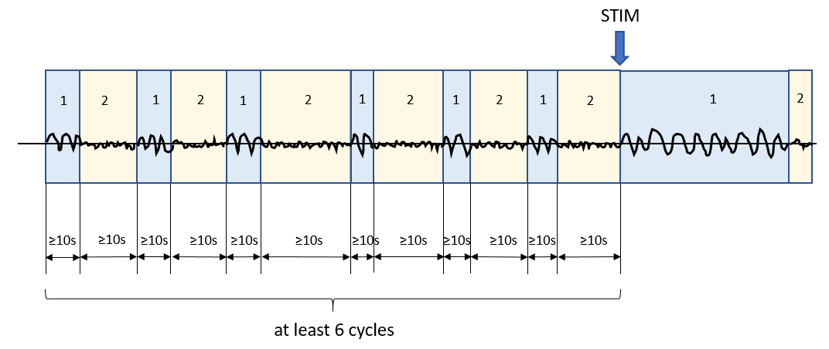
BACKGROUND: CYCLIC ALTERNATING PATTERN of ENCEPHALOPATHY (CAPE)
Cyclic Alternating Pattern of Encephalopathy (CAPE): Present, Absent, or Unknown/unclear. CAPE refers to changes in background patterns (which may include RPPs), each lasting at least 10 seconds, and spontaneously alternating between the 2 patterns in a regular manner for at least six cycles (but often lasts minutes to hours). A cycle refers to the period of time before the sequence repeats (i.e., includes both states once). Document whether seen in the patient’s more awake/stimulated state or less awake state if known. Describe each pattern and typical duration of each pattern. Optional: Describe if this pattern corresponds with cycling of other functions such as respirations, heart rate, blood pressure, movements, muscle artifact, and pupil size.
To qualify as CAPE, there must be the following:
Changes in background with
each pattern lasting at least 10 s,
spontaneously alternating between the two patterns in a regular manner,
for at least 6 cycles.

Slide 33
BACKGROUND: BREACH EFFECT
Breach effect: Present (provide location), Absent, Unclear. Breach effect refers to EEG activity over or nearby a skull defect and consists of activity of higher amplitude and increased sharpness, primarily of faster frequencies, compared with the rest of the brain, especially compared with the homologous region on the opposite side of the head.

Slide 34
In what region is breach effect present on this page of EEG?

Slide 35
BREACH, left parasagittal
(maximal at C3)
The skull attenuates cerebral rhythms from being propaged to surface EEG electrodes. If there is a “breach“ in the integrity of the skull (usually due to a neurosurgical intervention or trauma) a greater proportion of brain activity is allowed to pass through. The activity that is attenuated the most is low voltage high frequency activity, so the characteristics of a breach effect are a greater representation of this fast activity in the region of the breach; it often appears spikier as well, as seen here (compare the left paragasittal region in the box with the homologous region on the right, top 4 channels).

Slide 36
B. Sporadic Epileptiform Discharges

Slide 37
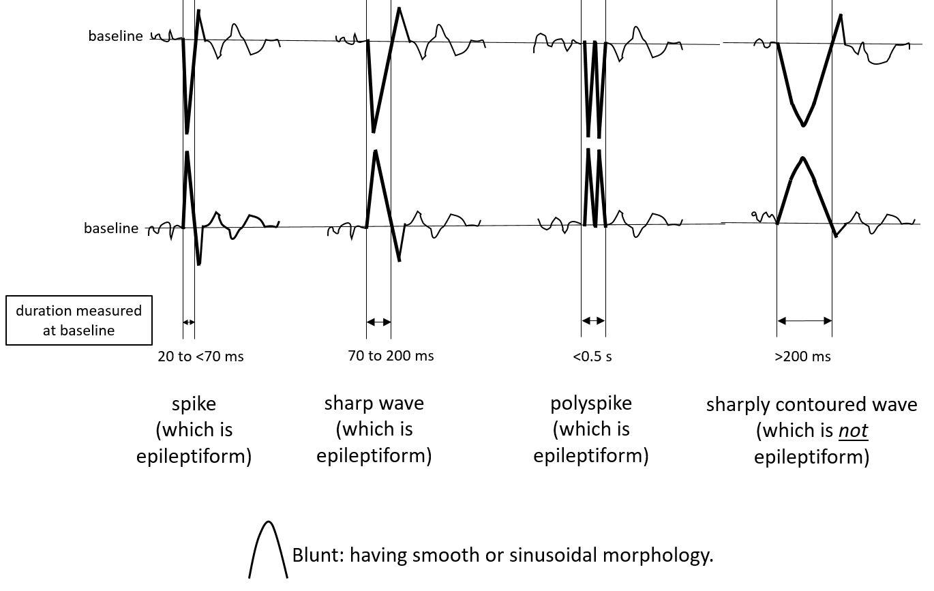
SPORADIC EPILEPTIFORM DISCHARGES

Slide 38
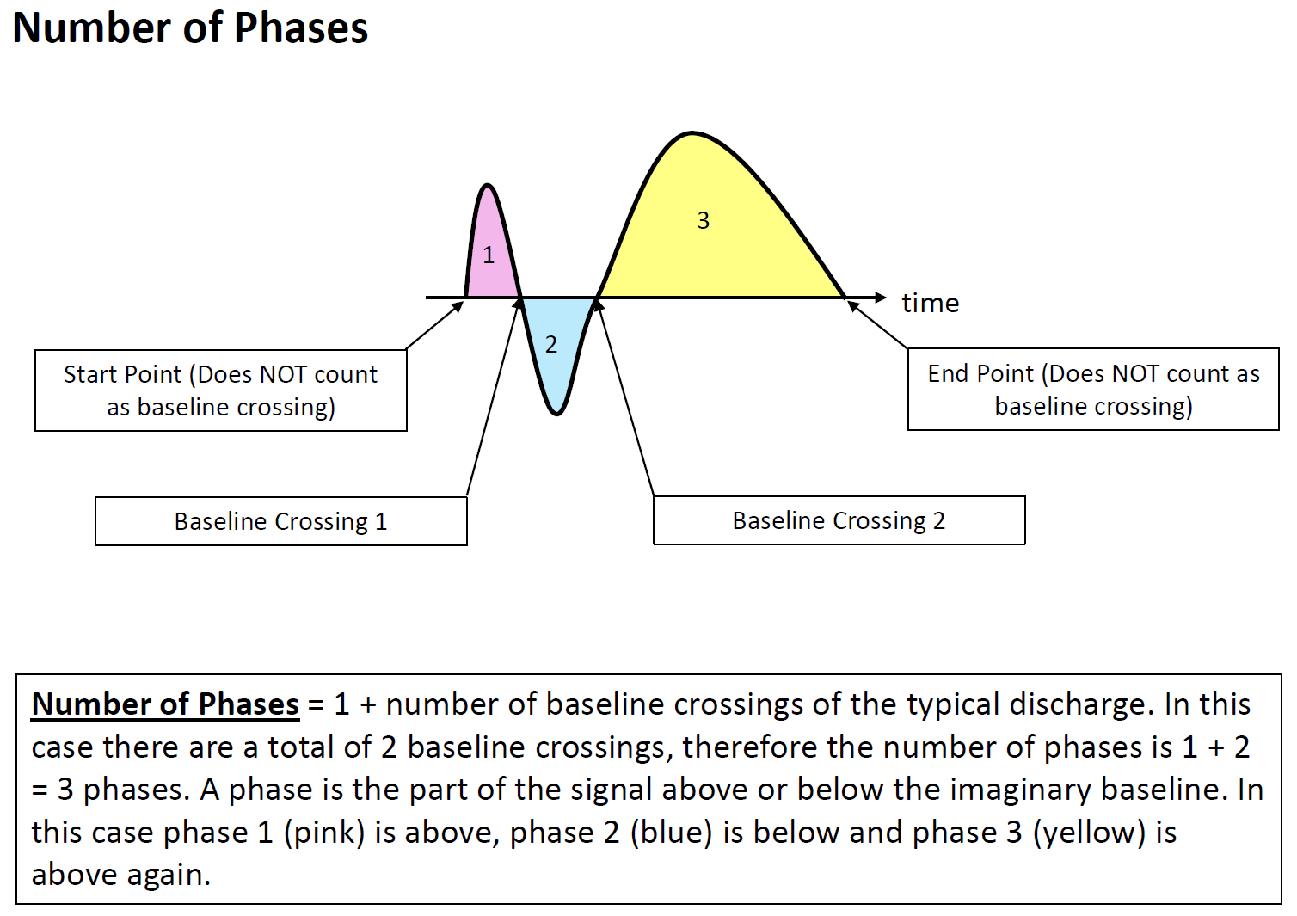
NUMBER OF PHASES

Slide 39
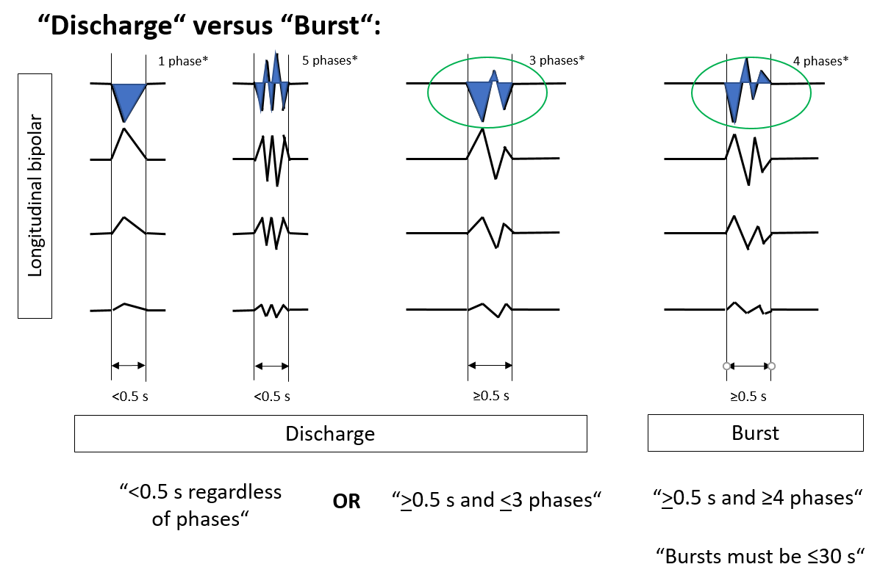
DISCHARGE VERSUS BURST

Slide 40
Sporadic: non-rhythmic and non-periodic epileptiform discharges (“interictal ED”)
SPORADIC EPILEPTIFORM DISCHARGES: PREVALENCE
Use the following standard time divisions or suggested equivalent clinical terms:
>1 /10s (Abundant) (average ≥1 / typical EEG page)
>1/min –1/10s (Frequent)
> 1/h - 1/min (Occasional)
<1/h (Rare)

Slide 41
C. Rhythmic and Periodic Patterns (RPPs)

Slide 42
RHYTHMIC AND PERIODIC PATTERNS (RPPs): MAIN TERMS
All rhythmic and periodic patterns (RPPs) should be described by main terms 1 and 2, as well as appropriate major and minor modifiers. Not all modifiers will apply to every pattern.
Main term #1 (localization) (G) Generalized (L) Lateralized (BI) Bilateral Independent (Mf) Multifocal | Main term #2 (pattern) (PDs) Periodic Discharges (RDA) Rhythmic Delta Activity (SW) (Poly)Spike-&-Wave/Sharp- and-Wave
NEW 2021:
(UI) Unilateral Independent

Slide 43
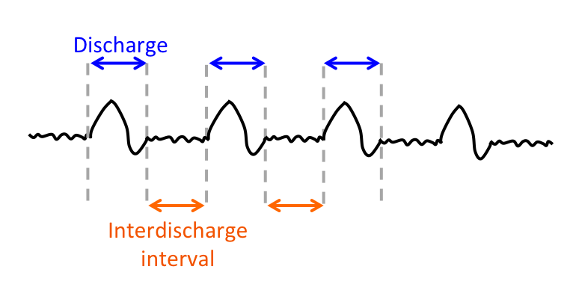
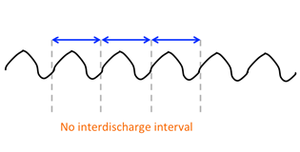
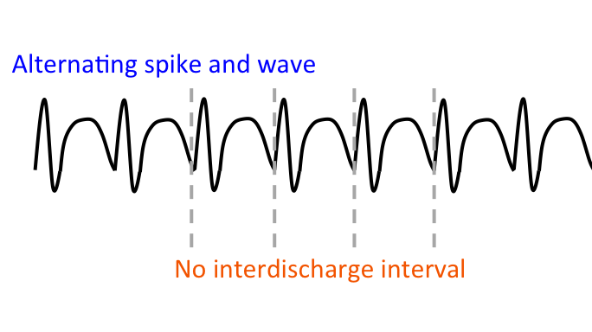
RHYTHMIC AND PERIODIC PATTERNS (RPPs): MAIN TERM 2
Main term 2 (pattern description) includes:
PD: Periodic Discharges
RDA: Rhythmic Delta Activity
SW: Spike-and-Wave, Sharp-and-Wave or
Polyspike-and-Wave

Slide 44
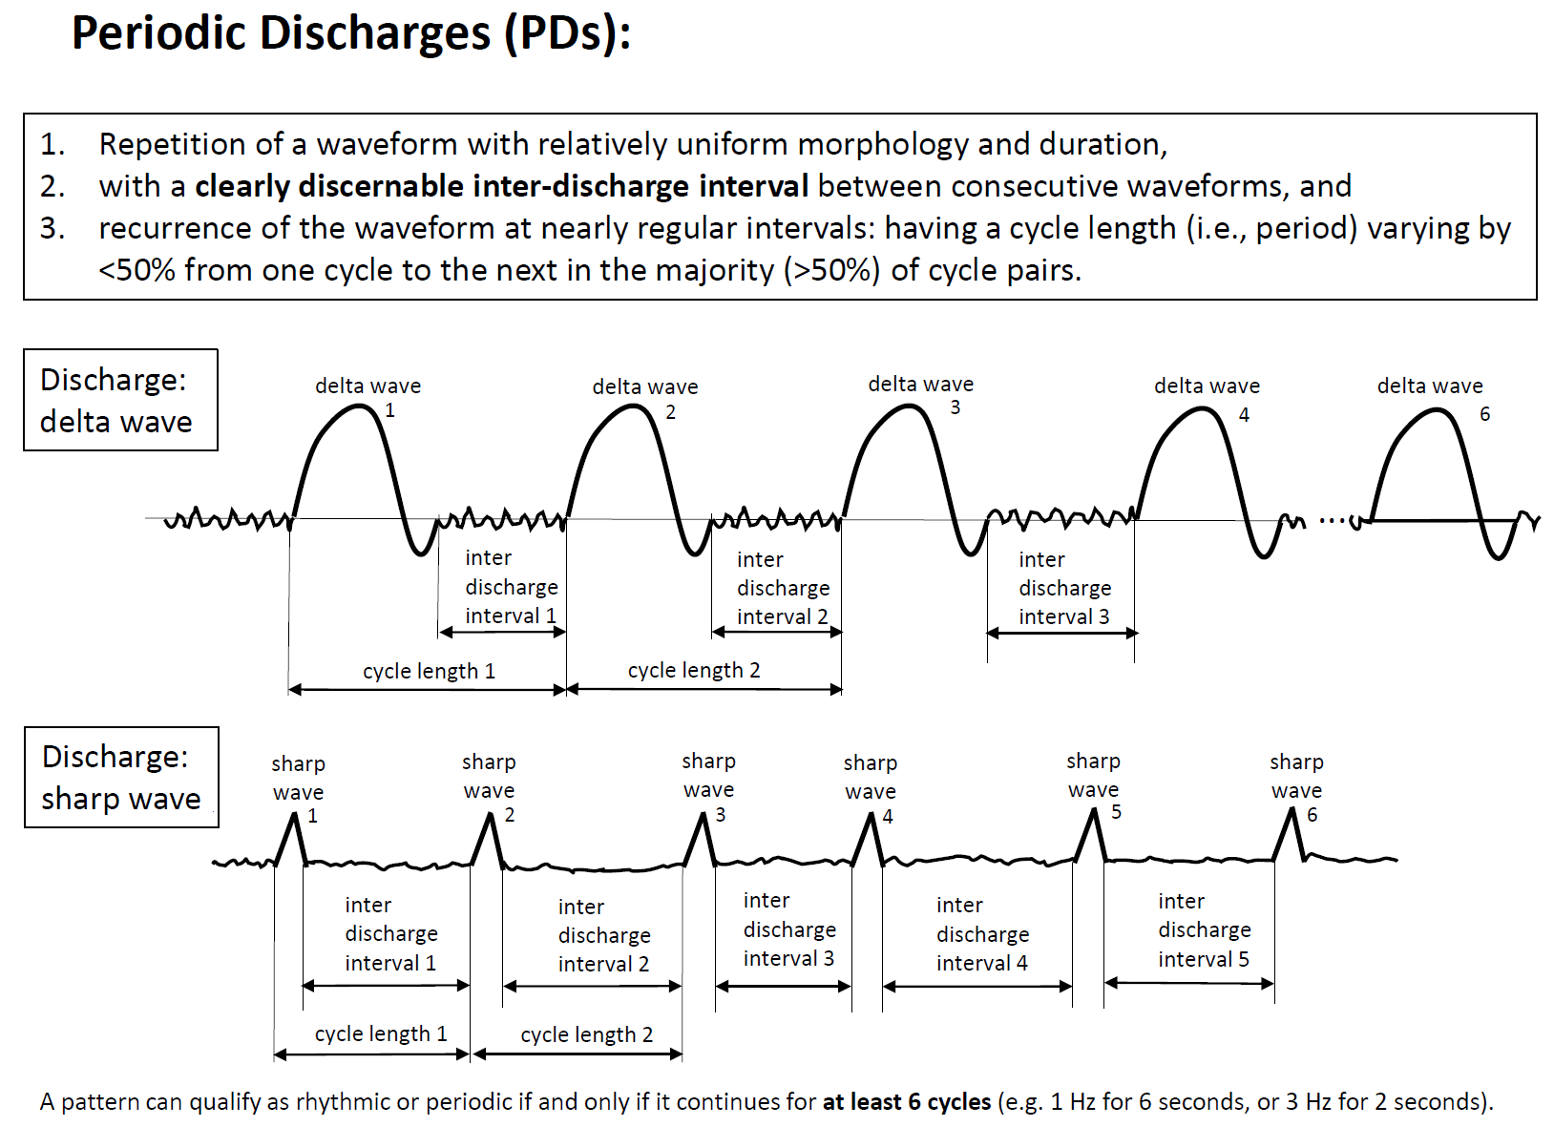
MAIN TERM 2: PDs
NOTE: PDs can be blunt as shown in first example. (Blunt: having a smooth or sinusoidal morphology.)

Slide 45
MAIN TERM 2: RDA
polymorphic, also known as
irregular or arrhythmic
NOT RDA

Slide 46
MAIN TERM 2: SW
Spike-and-wave or Sharp-and-wave (SW): Polyspike, spike or sharp wave consistently followed by a slow wave in a regularly repeating and alternating pattern (spike-wave-spike-wave-spike-wave), with a consistent relationship between the spike (or polyspike or sharp wave) component and the slow wave for at least 6 cycles; and with no interval between one spike-wave complex and the next (if there is an interval, this would qualify as PDs, where each discharge is a spike-and-wave).
Spike-and-Wave Sharp-and-Wave
Longitudinal bipolar
1
2
3
4
5
6
1
2
3
4
5
6
20 to <70 ms
70 to 200 ms
duration measured at baseline
duration measured at baseline

Slide 47
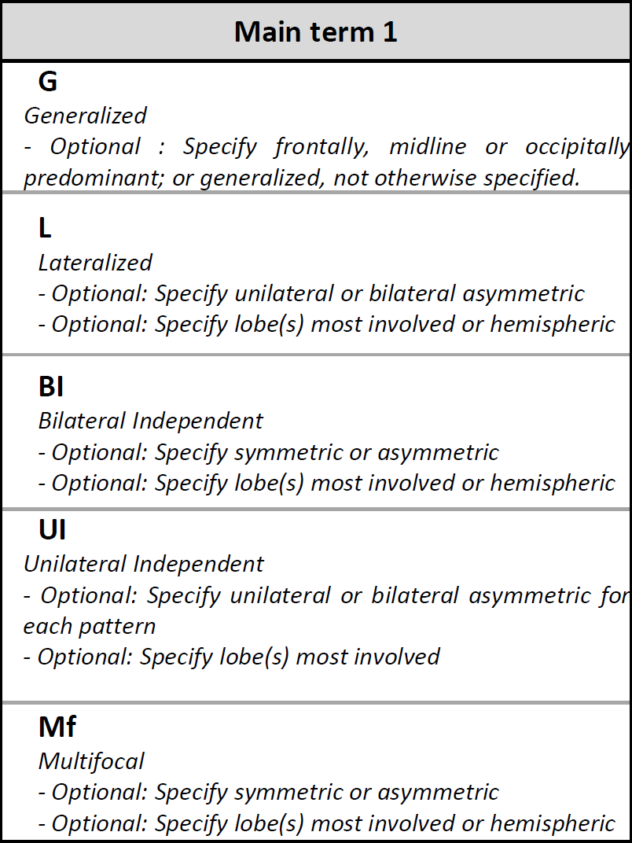
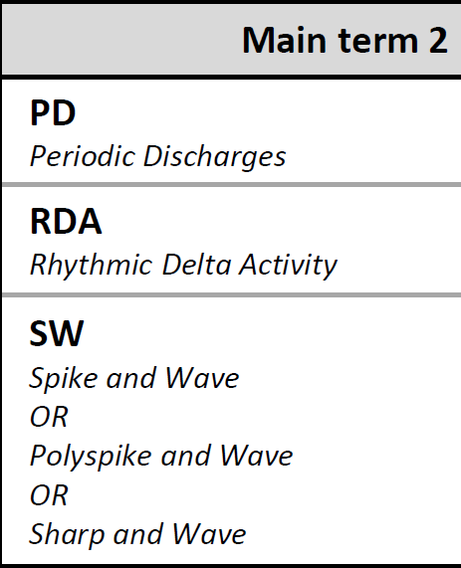
MAIN TERM 1: GENERALIZED
LEFT
Generalized: Bilateral synchronous and symmetric periodic discharges. In this case the pattern is “frontally predominant“
Longitudinal bipolar montage
RIGHT
Main term 1 (localization) terms have been demonstrated with periodic discharges (PDs).
In practice, any main term 1 can be combined with any main term 2

Slide 48
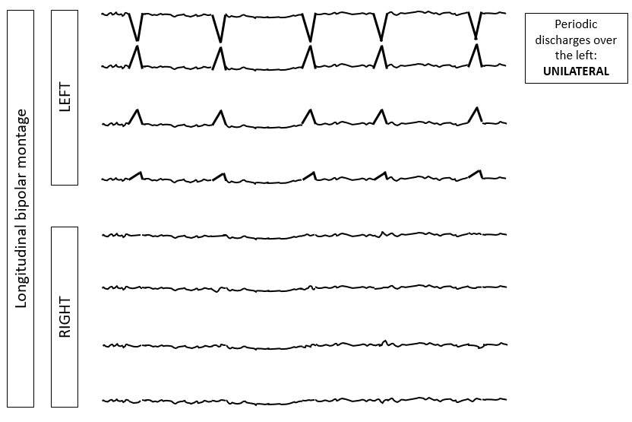
MAIN TERM 1: LATERALIZED

Slide 49
MAIN TERM 1: BILATERAL INDEPENDANT
Periodic discharges over the left
LEFT
Longitudinal bipolar montage
Independent periodic discharges over the right
RIGHT
Note: In BIPDs, lateralized patterns occur on each hemisphere asynchronously and at different frequencies.

Slide 50
MAIN TERM 1: UNILATERAL INDEPENDANT
Note: In UIPDs, 2 or more lateralized patterns occur within the same hemisphere asynchronously and at different frequencies.

Slide 51
MAIN TERM 1: MULTIFOCAL

Slide 52
MAJOR MODIFIERS
In addition to main terms 1 and 2, the following major modifiers can be applied to refine the description of the pattern:
Prevalence
Duration
Frequency
Phases
Sharpness
Voltage
Stimulus-Induced (SI-) or Stimulus-Terminated (ST-) (new in 2021)
Evolution
Plus (+)

Slide 53
FREQUENCY/DURATION/PREVALENCE
Note that there are 4 distinct time-related scales:
1. Frequency
refers to the rate per second or the number of cycles of a pattern within 1 second. Maximum, minimum, and typical frequencies can be recorded. Frequencies are expressed in hertz (Hz) that equates with cycles per second.
<0.5, 0.5, 1, 1.5, 2, 2.5, 3, 3.5, and 4 Hz
2. Duration
refers to the typical duration of a single occurrence of the pattern, regardless of whether the pattern occurs rarely or frequently, categorized as:
very long, long, intermediate duration, brief, very brief
3. Prevalence
refers to percent of the entire record occupied by a pattern, categorized as:
continuous, abundant, frequent, occasional, rare
The best estimate of prevalence, when given as a single number, is also known as the “burden” of that pattern. E.g., seizure burden of 40%, or IIC burden of 40%, or PD burden of 40%.
4. Quantification of sporadic epileptiform discharges
refers to how often sporadic (non-periodic) epileptiform discharges are present in the record, categorized as:
abundant, frequent, occasional, rare

Slide 54
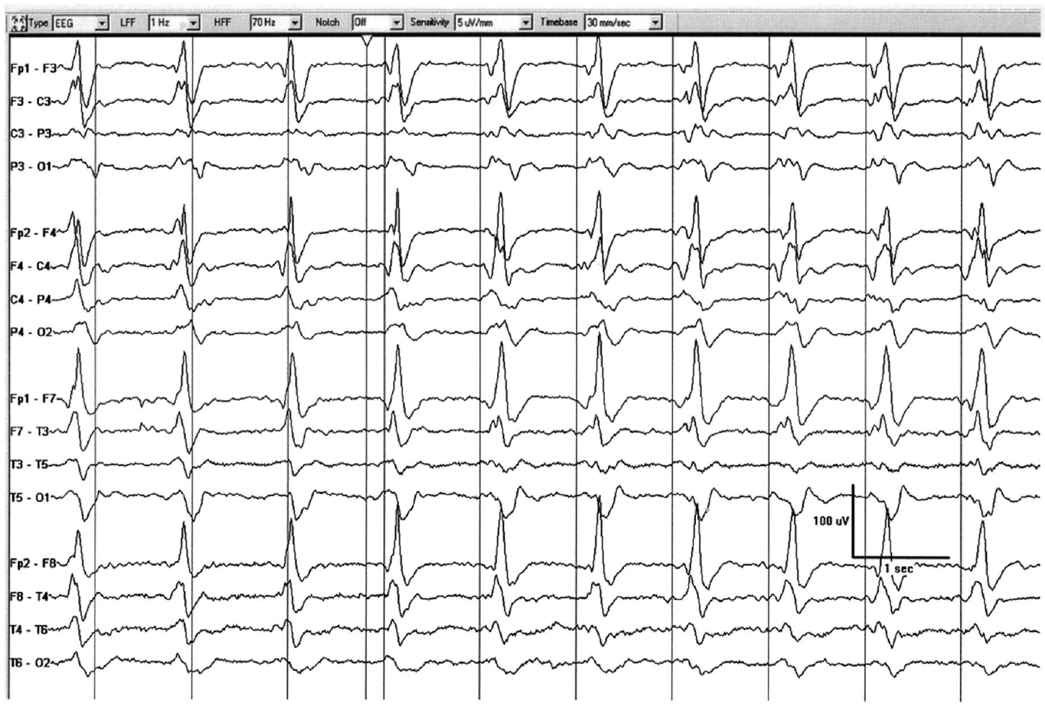
What pattern is this?

Slide 55
Frontal predominance
10 discharges in
10 seconds → 1 Hz
Sharp morphology
110 ms
DISCHARGE:
< 0.5s,
regardless of phases
440 ms
Generalized Periodic Discharges, GPDs (frontally predominant, sharp, 1 Hz)

Slide 56
Frontal predominance
It is still a “discharge“ despite exceeding 0.5s as it has only 3 phases (colored).
Sharp morphology
110 ms
10 discharges in
10 seconds → 1 Hz
DISCHARGE:
≥ 0.5s BUT ≤ 3 phases
510 ms
3 phases (blue green, orange)
Generalized Periodic Discharges, GPDs (frontally predominant, sharp, 1 Hz, 3 phases)

Slide 57
PERIODIC DISCHARGES: SHARPNESS
Applies to PDs and the S phase of SW
spiky
~60 ms
~170 ms
sharp
1 second
Sharpest phase: spiky (<70 ms)
Predominant phase (greatest amplitude): sharp (70-200 ms)

Slide 58
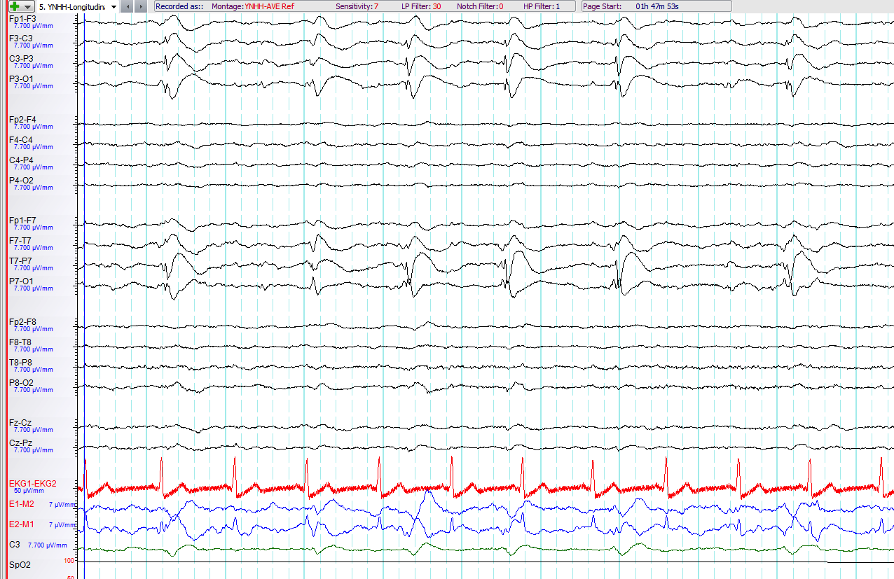
Please characterize the pattern

Slide 59
Morphology of one discharge: spike-and-wave, but pattern is LPDs
LATERALIZED PERIODIC DISCHARGES
Lateralized Periodic Discharges, LPDs
(spiky, with spike-and-wave morphology)
Despite their spike-and-wave morphology, these are PDs (not SW) as there is a clear interdischarge interval

Slide 60
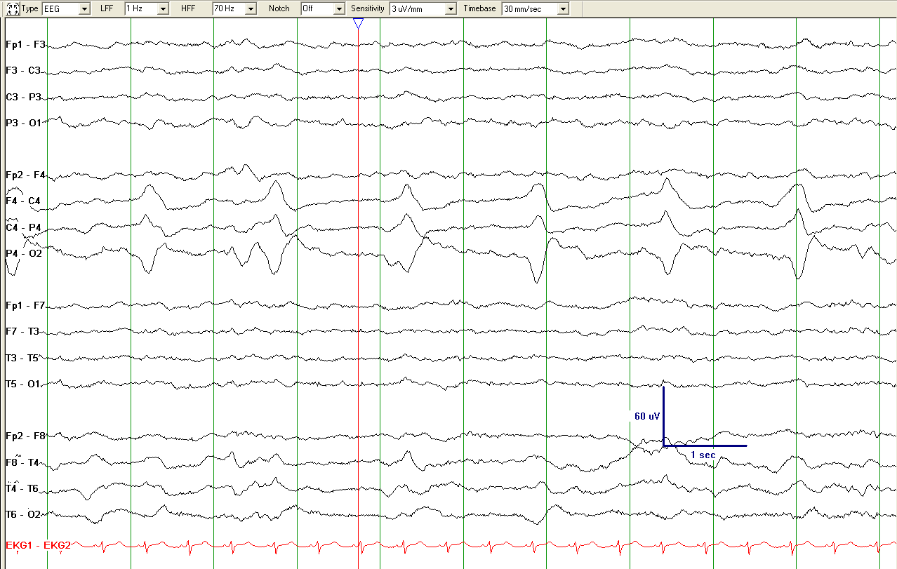
Lateralized Periodic Discharges (LPDs)
Please describe this pattern

Slide 61
Sharpness: SHARPLY CONTOURED
as duration > 0.2 s
~ 0.37 s
7 EDs/10.5 s= 0.67 → 0.5-1 Hz
Lateralized Periodic Discharges (LPDs)
Lateralized Periodic Discharges, LPDs (right parietal maximum, sharply contoured, positive polarity, 0.5 - 1 Hz) NOTE: even though the dischages are sharply contoured (i.e., not spiky or sharp), they are still a periodic pattern (LPDs here).

Slide 62
Please characterize the pattern

Slide 63
LATERALIZED (bilateral asymmetric):
bilateral, but clearly and consistently higher amplitude in left hemisphere = LATERALIZED. [Consistently: >80% of the time.]
PERIODIC:
with interdischarge intervals, in green circles
DISCHARGES:
here: duration ≥500 ms but only one or two phases, therefore still discharges, not bursts.
Lateralized Periodic Discharges, LPDs
(bilateral asymmetric, 0.5-1 Hz)

Slide 64
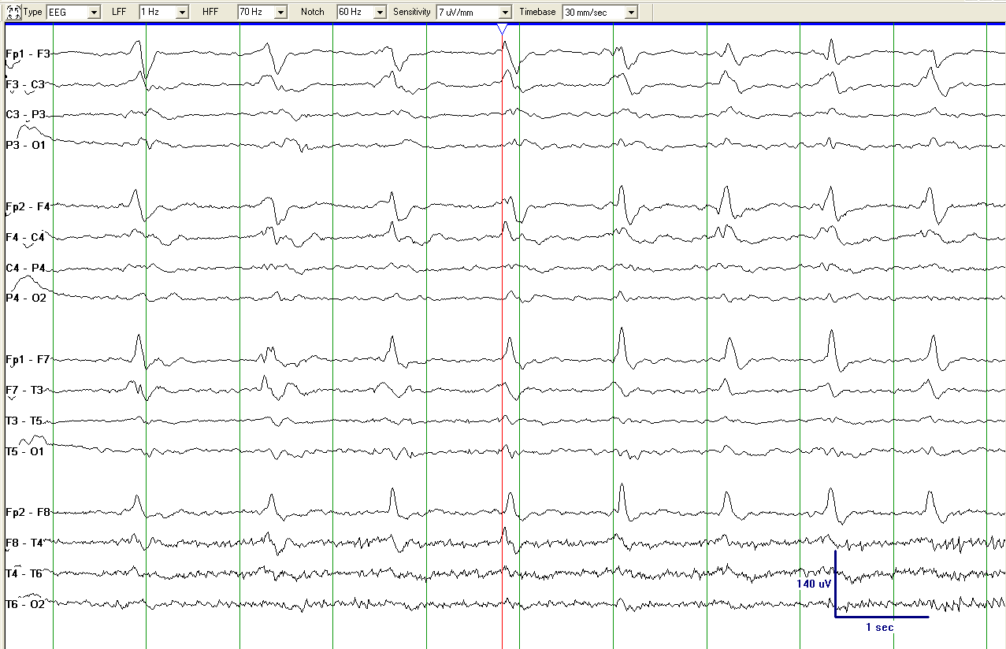
Generalized Periodic Discharges (GPDs)
What would you call this pattern?

Slide 65
higher on RIGHT
Note that the term “generalized“ allows for higher voltage on one side if there are also discharges with higher voltages on the other side (“shifting predominance“ or more specific “shifting asymmetry“).
If the asymmetry clearly and consistently favors one hemisphere then this would be “lateralized - bilateral asymmetric“; that is not the case here.
higher on LEFT
Generalized Periodic Discharges (GPDs)
Generalized Periodic Discharges (GPDs), with shifting asymmetry
(bifrontal maximal, sharp, 1.0 Hz)

Slide 66
What is the correct term for this pattern?
Reproduced with permission from Hirsch LJ, Fong MWK, Brenner RP. Atlas of EEG in Critical Care, second edition, Wiley: 2022

Slide 67
Lateralized Rhythmic Delta Activity (LRDA)
(Left anterior-mid temporal maximum, 1.5 Hz)
Reproduced with permission from Hirsch LJ, Fong MWK, Brenner RP. Atlas of EEG in Critical Care, second edition, Wiley: 2022

Slide 68
Please describe the pattern:
Reproduced with permission from Hirsch LJ, Fong MWK, Brenner RP. Atlas of EEG in Critical Care, second edition, Wiley: 2022

Slide 69
Polymorphic delta activity (a.k.a. irregular, arrhythmic)
(This is NOT LRDA; RDA has to be rhythmic. This is just focal slowing)
Reproduced with permission from Hirsch LJ, Fong MWK, Brenner RP. Atlas of EEG in Critical Care, second edition, Wiley: 2022

Slide 70
Please describe the pattern
Reproduced with permission from Hirsch LJ, Fong MWK, Brenner RP. Atlas of EEG in Critical Care, second edition, Wiley: 2022

Slide 71
(Advanced comment: The fast activity is present even after the RDA ends; thus, this is not +F, just LRDA with no plus. This also means it can not be Extreme Delta Brush pattern.)
Lateralized Rhythmic Delta Activity, LRDA
(Right frontocentral maximum, 1.0 Hz)
Reproduced with permission from Hirsch LJ, Fong MWK, Brenner RP. Atlas of EEG in Critical Care, second edition, Wiley: 2022

Slide 72
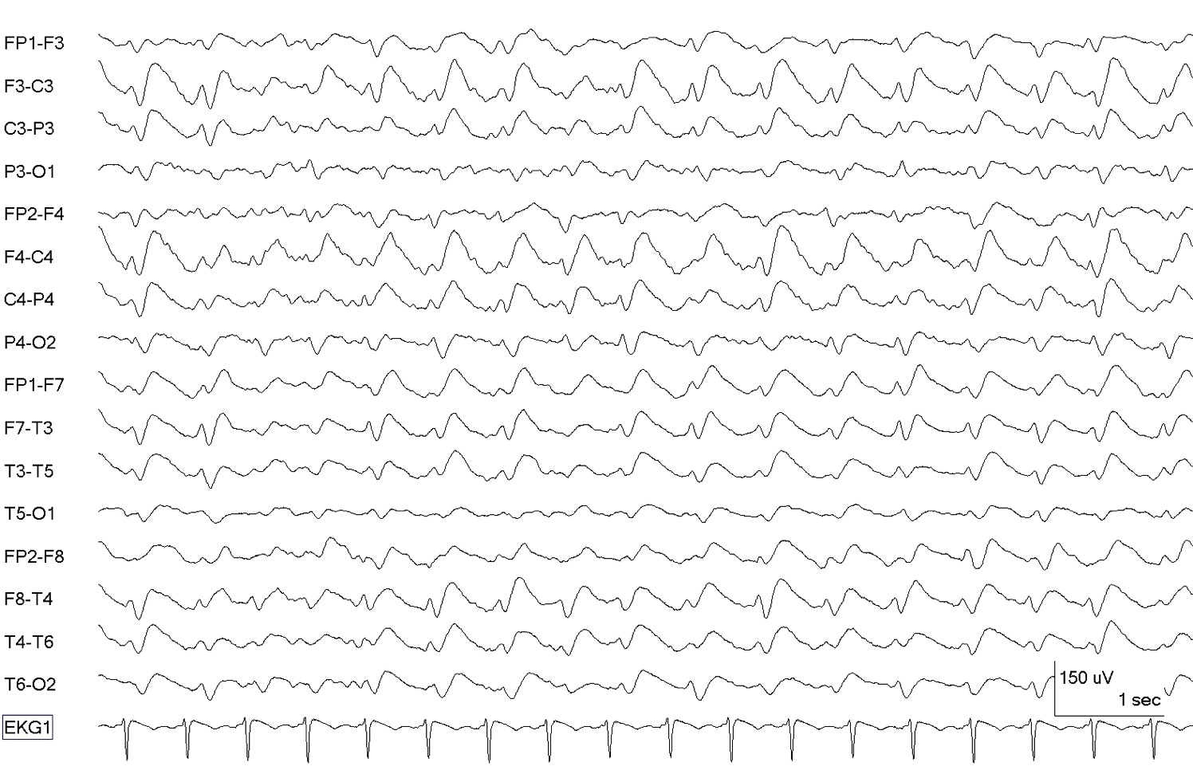
What is the correct term for this pattern?

Slide 73
17 EDs/10 s
→ 1.5 Hz
Sharp-and-wave: NO interdischarge intervals
SHARP
90 ms
Generalized sharp-and-wave, GSW
(bifrontal maximum, 1.5 Hz)

Slide 74
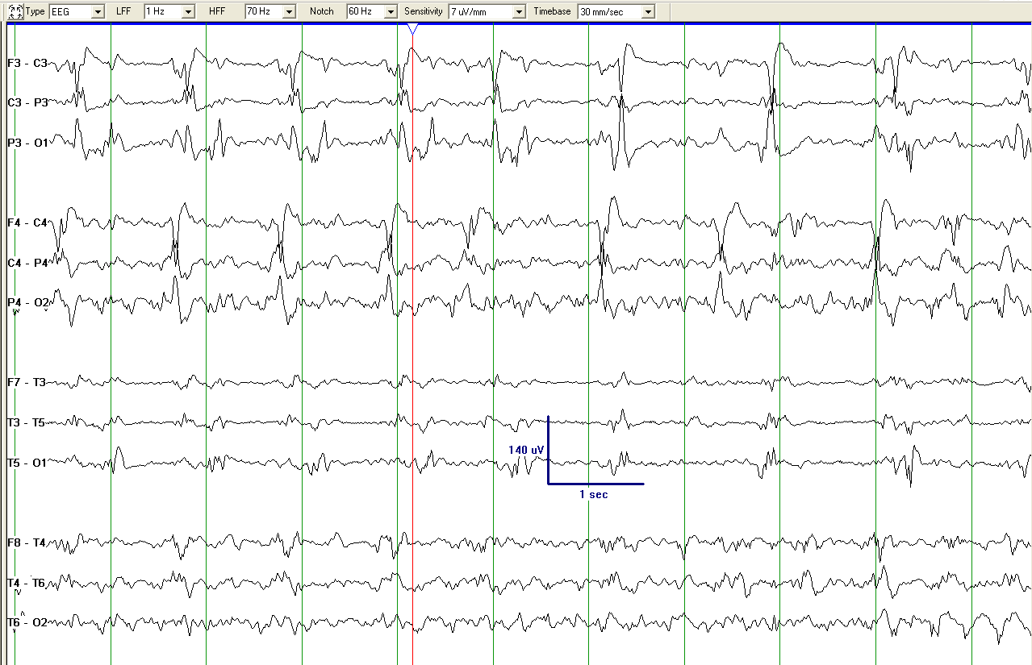
What pattern(s) is this?

Slide 75
Left centroparietal
Right central
BIPDs
Lateralized Periodic Discharges (LPDs)
Bilateral Independent Periodic Discharges BIPDs

Slide 76
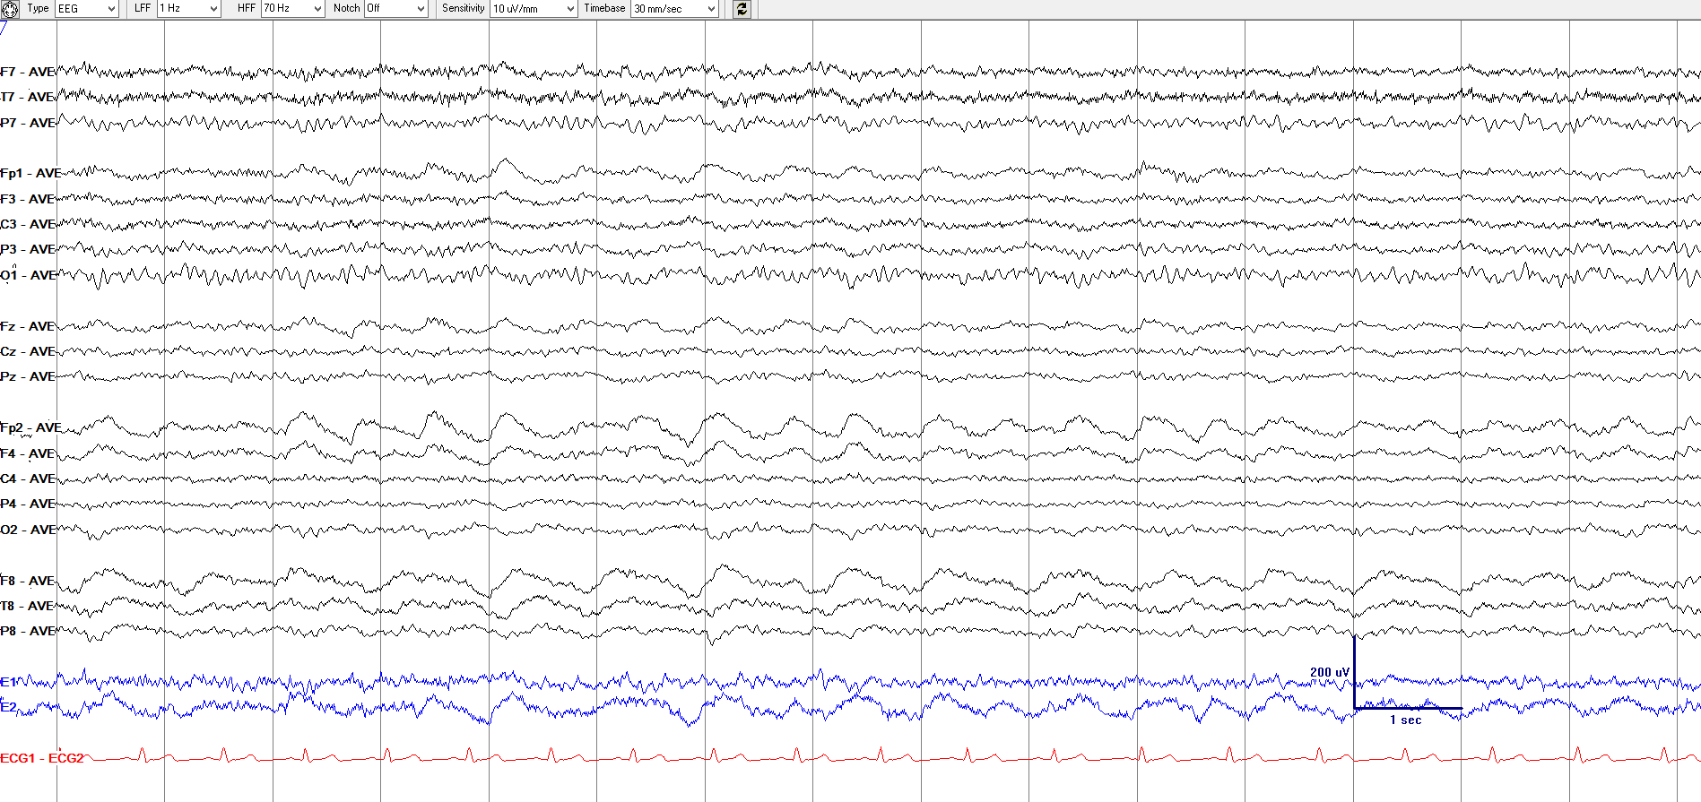
What is the correct term for this pattern?

Slide 77
Unilateral Independant Rhythmic Delta Activity, UIRDA
(Right frontopolar maximum [solid lined box]: 1.5 Hz; Right anterior temporal maximum [dashed box]: 1.0 Hz)
Advanced comment: The fast activity is diffuse and NOT time-locked to the RDA, therefore NO plus and NO delta-brush pattern.

Slide 78
What would you call this pattern?

Slide 79
Left frontal
12 EDs/10 s
→ 1.0 Hz
Vertex
5 EDs/10 s
→ 0.5 Hz
Focal midline patterns can be deemed in the same
hemisphere (ipsilateral) as an independent pattern in either the left or right hemisphere.
For example, PDs at 1 Hz in the left hemisphere occurring simultaneously with independent focal midline PDs at 0.5 Hz would still qualify as unilateral independent periodic discharges.
Unilateral Independent Periodic Discharges, UIPDs
(orange: maximum left frontal, 1.0 Hz; green: maximum at vertex [Cz], 0.5 Hz)

Slide 80
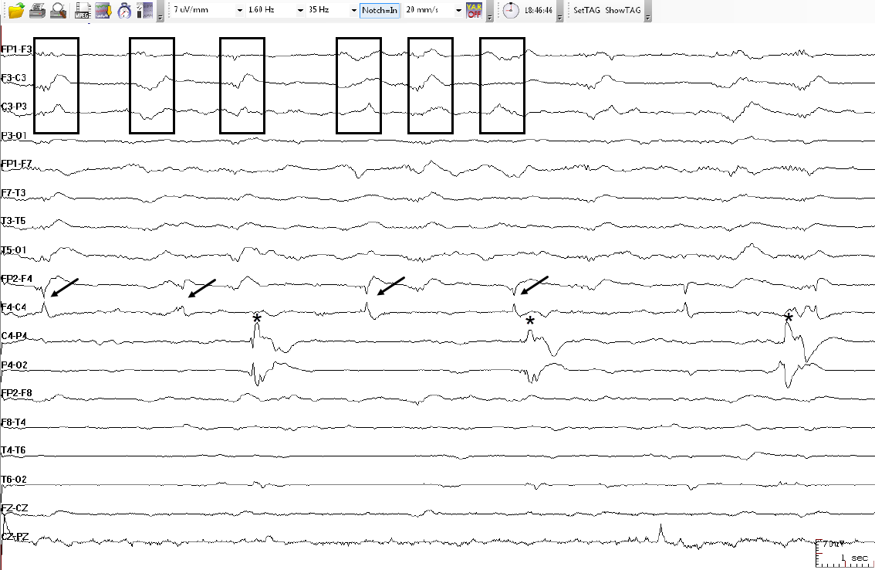
This pattern is best classified as:
Courtesy of
Dr. Luis Octavio Caboclo

Slide 81
Left frontal, ~1 Hz
Right frontal, ~0.5 Hz
Right parietal, ~0.3 Hz
Multifocal Periodic Discharges, MfPDs: 3 independent foci, 1 left, 2 right
Courtesy of
Dr. Luis Octavio Caboclo

Slide 82
MAJOR MODIFIERS: PREVALENCE
How often and how long a pattern is present can be described by prevalence and duration:
Prevalence: The percent of the record or epoch that includes the pattern, using the following divisions:
>90% Continuous
50-89% Abundant
10-49% Frequent
1-9% of Occasional
<1% of Rare

Slide 83
MAJOR MODIFIERS: DURATION
Typical duration of pattern: The typical duration of a pattern, using the following divisions: (i.e., how long a pattern typically lasts)
>1 hour Very long
10-59 min Long [2021 revision, to match ILAE def’n of status epilepticus that is not convulsive (10 min)]
1-9.9 min Intermediate duration
10-59 sec Brief
<10 sec Very brief

Slide 84
“PLUS” MODIFIER
The Plus modifier refers to additional features that render the pattern more ictal-appearing than the same pattern without the plus. The Plus modifier can be characterized as:
+F superimposed fast activity
(theta or faster; for PDs or RDA)
+R superimposed rhythmic or quasi rhythmic delta activity (for PDs only)
+S superimposed sharp waves/spikes (at least >1/10s but not periodic and not spike-and-wave, SW) or sharply contoured (for RDA only)
+FR if both subtypes apply (for PDs only)
+FS if both subtypes apply (for RDA only)

Slide 85
PERIODIC DISCHARGES PLUS FAST (PDs+F)
code as +F if the fast activity is part of the RDA or PD pattern and not simply part of the background activity
EXAMPLE A: PDs+F
fast activity associated with each discharge
Longitudinal bipolar
EXAMPLE B: PDs+F
4
5
6
Longitudinal bipolar
OR …
NOTE: fast activity cycling with the periodic discharge

Slide 86
code as +F if the fast activity is part of the RDA or PD pattern and not simply part of the background activity
EXAMPLE C: PDs+F
Longitudinal bipolar
EXAMPLE D: PDs (NOT +F, as fast activity is part of the background and present even when the pattern is not)
4
5
6
Longitudinal bipolar

Slide 87
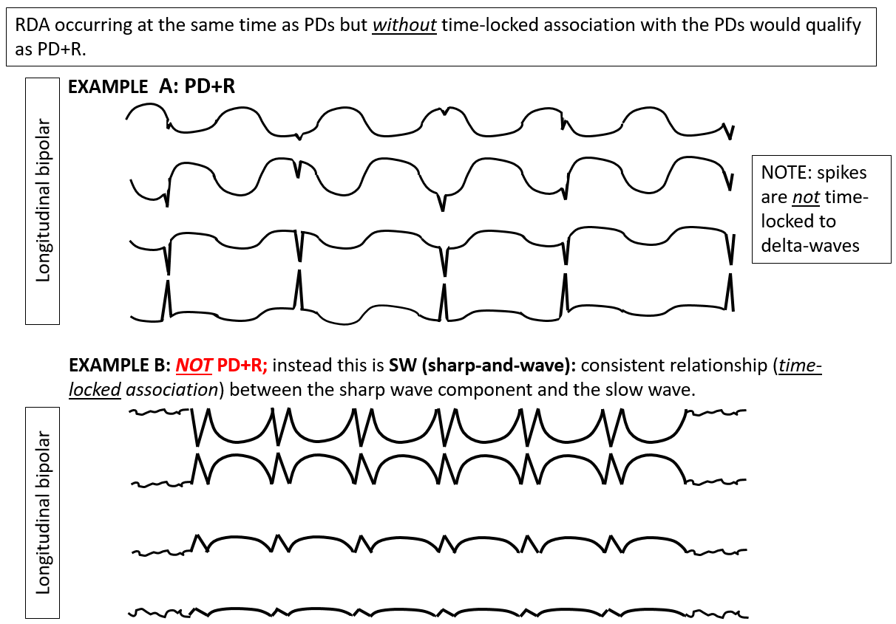
PERIODIC DISCHARGES PLUS RDA (PDs+R)

Slide 88
RHYTHMIC DELTA ACTIVITY PLUS SPIKES or SHARP WAVES (RDA+S)
Rhythmic delta activity (in this case over the left hemisphere) with associated spikes.
NOTE the discharges are not periodic (compared to example A, prior slide). If a pattern qualifies as PDs+R and RDA+S it is suggested that it be classified as PDs+R. If the spike/sharp component forms a stereotyped relationship with each wave and there is no inter-discharge interval it would likely qualify as SW (example B, prior slide)
LEFT

Slide 89
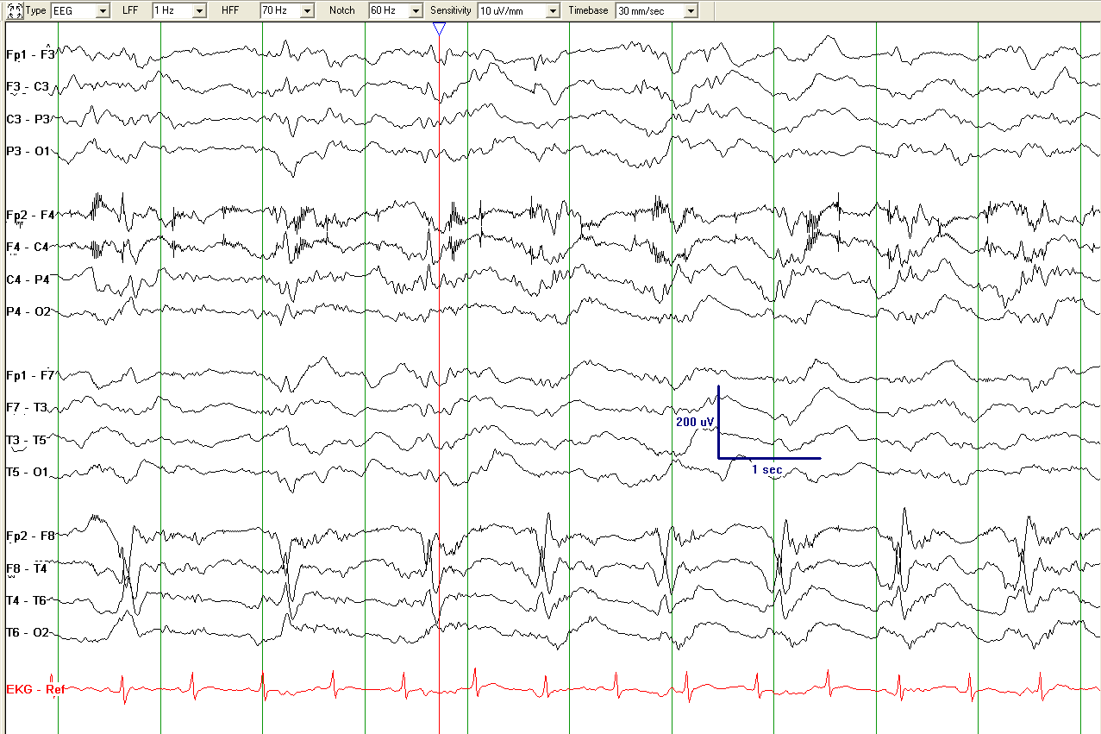
Spiky LPDs+F
Please describe the pattern

Slide 90
Artifact
Fast activity:
Spiky LPDs+F
Lateralized Periodic Discharges with superimposed fast activity, LPD+F
(Lateralized: bilateral asymmetric, right temporal maximum, 1 Hz)

Slide 91
What is the best way to describe this pattern?

Slide 92
Left LRDA, 1.5-2 Hz
Lateralized Rhythmic Delta Activity, LRDA+S
(it`s +S due to the sharp waves shown by the asterisks)

Slide 93
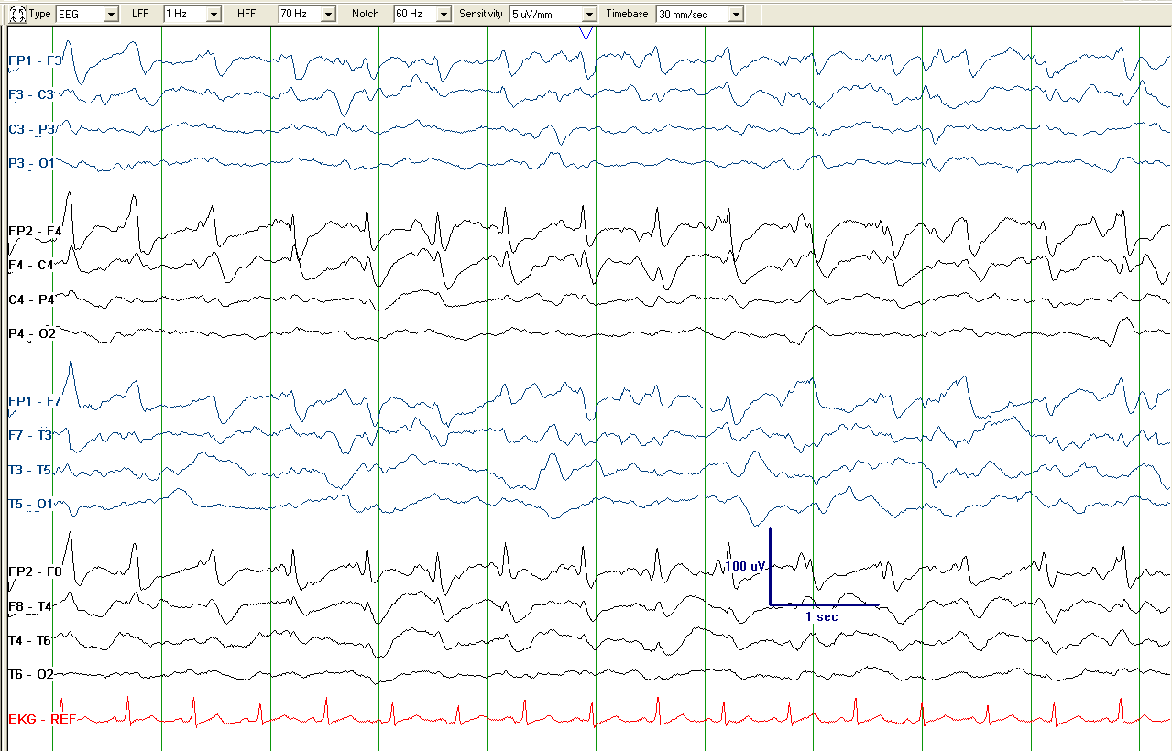
What is the correct term of this pattern?

Slide 94
Sharpness: sharp
Sharpness: spiky
Not LSW since sharp waves are not time locked to delta waves for 6 or more cycles, but close
Rhythmic activity
Lateralized Periodic Discharges with superimposed Rhythmic Delta Activity: LPD+R
(Lateralized: bilateral asymmetric, spiky and sharp, 1.5 Hz)

Slide 95
Please describe the pattern

Slide 96
Rhythmic activity
24 discharges in
14 seconds → 1.5 - 2 Hz
Lateralized Periodic Discharges + R (Ictal-Interictal Continuum, IIC)
1.5-2 Hz LPD+R, therefore on the ictal-interictal continuum (discussed later); not >2.5 Hz and not evolving, so does not qualify as a definite electrographic seizure, even though there is a reasonable chance it could cause symptoms or neuronal injury.

Slide 97
EXTREME DELTA BRUSH (EDB)
“Extreme Delta Brush (EDB)”: A specific subtype of +F:
Definite EDB: Consists of either abundant or continuous:
A. RDA+F, in which the fast activity has a stereotyped relationship to the delta wave (e.g., always maximal
on the upstroke, crest, or downstroke of the wave);
OR
B. PDs+F, in which each PD consists of a single blunt delta wave with superimposed fast activity, and in which
the fast activity has a stereotyped relationship to the delta wave (i.e., periodic delta brushes)
Possible EDB:
Satisfying criterion A) or B) above EXCEPT either:
i. only occasional or frequent (rather than abundant or continuous)
OR
ii. the superimposed fast activity lacks a stereotyped relationship to the delta wave; continuous, invariant fast
activity during RDA would fall into this category

Slide 99
EXTREME DELTA BRUSH (EDB)

Slide 100
EXTREME DELTA BRUSH (EDB)
This is not +F since the fast activity is present even when the RDA is not.

Slide 101
What is the correct term for this pattern?

Slide 102
Periodic blunt delta waves with superimposed beta in a stereotyped relationship to the delta waves.
Generalized Periodic Discharges with superimposed fast activity (GPD+F) (Bifrontal maximum, 0.5 Hz): If abundant/ continuous, this is definite EDB; if it‘s frequent/occasional, it is possible EDB.

Slide 103
MAJOR MODIFIERS: EVOLVING, FLUCTUATING or STATIC
Evolving and fluctuating refer to changes in at least one of the following:
Frequency
Location
Morphology
(not amplitude alone)
If neither term applies, report as static.

Slide 104
MAJOR MODIFIERS: EVOLVING
At least 2 unequivocal, sequential changes in frequency, morphology or location defined as follows:
Frequency: ≥2 consecutive increases or decreases of ≥0.5 Hz, (e.g., 2 → 2.5 to 3 Hz, or 3 → 2 to 1.5 Hz)
Morphology: ≥2 consecutive changes to a novel morphology
Location: sequentially spreading into or out of ≥2 different standard 10-20 electrode locations
NOTE:
if evolving and >10s: it’s a seizure.
If evolving, 0.5-10s and reaches >4 Hz, it’s a BIRD (definite due to evolution)
If evolving, <10s and never >4 Hz, just use the modifier “evolving”, e.g., “very brief evolving RDA”

Slide 105
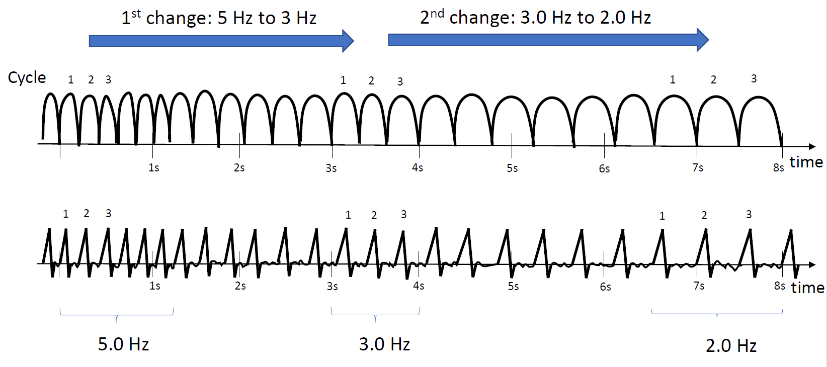
EVOLUTION OF FREQUENCY
At least 2 unequivocal, sequential changes in frequency defined as follows: Evolution in frequency is defined as at least 2 consecutive changes in the same direction by at least 0.5 Hz. In order to qualify as present, a single frequency must persist for at least 3 cycles. The criteria for evolution must be reached without the evolving feature (frequency) remaining unchanged for 5 or more continuous minutes.

Slide 106
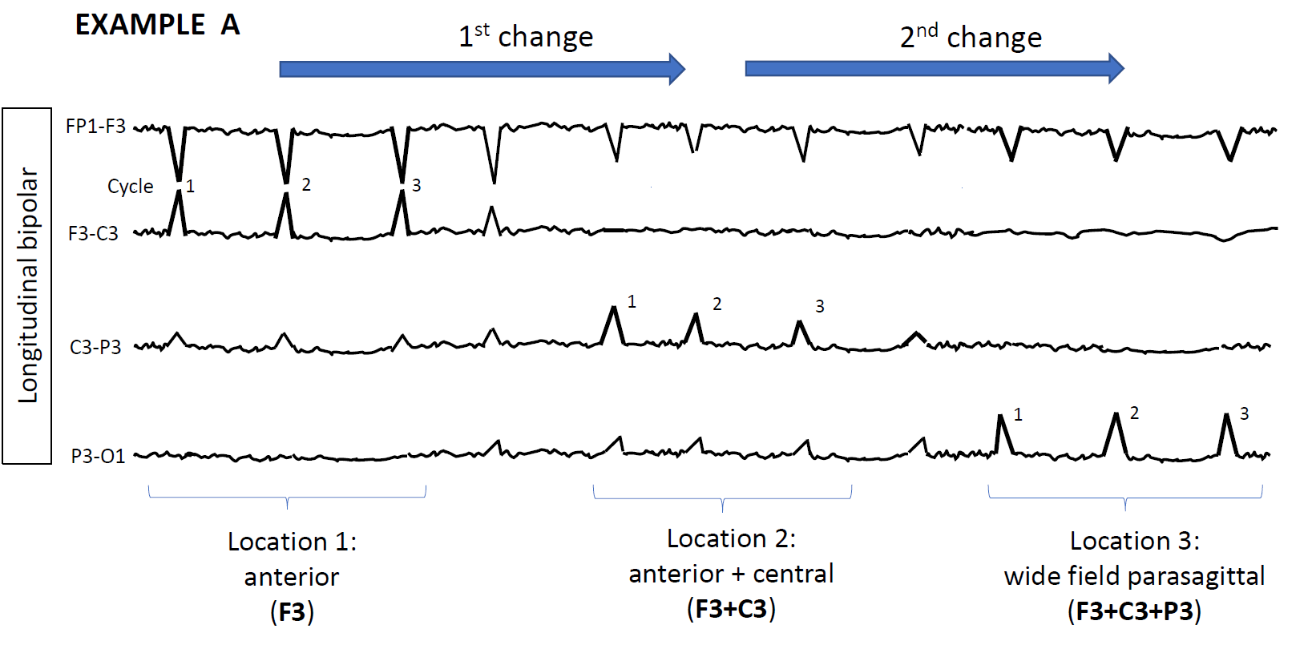
EVOLUTION OF LOCATION
Evolution in location is defined as sequentially spreading into or sequentially out of at least two different standard 10-20 electrode locations. The two consecutive changes must be in the same category (location) to qualify.
In order to qualify as present, a single location must persist for at least 3 cycles.
At least 2 consecutive changes to a novel morphology.

Slide 107
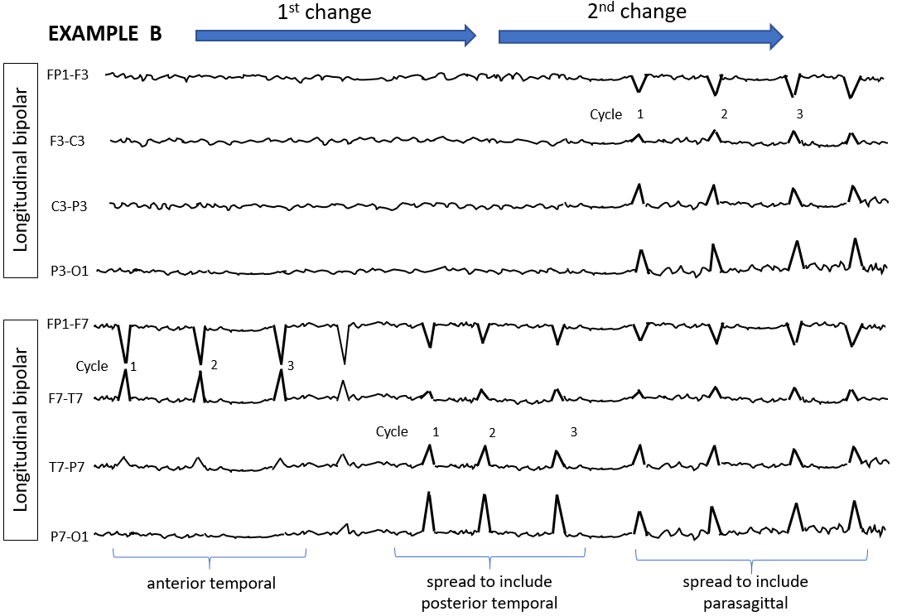
EVOLUTION OF LOCATION
At least 2 consecutive changes to a novel morphology.

Slide 108
MAJOR MODIFIERS: FLUCTUATING
At least 3 changes, <1 min apart, in:
Frequency (by ≥0.5/s),
Morphology, or
Location (by ≥1 standard inter-electrode distance),
BUT not qualifying as evolving.

Slide 109
FLUCTUATION in FREQUENCY
>3 changes, not more than one minute apart, in frequency (by at least 0.5 Hz), but not qualifying as evolving.
This includes patterns fluctuating from 1 to 1.5 to 1 to 1.5 Hz.
In order to qualify as present, a single frequency must persist at least 3 cycles (e.g., 1 Hz for 3 s, or 3 Hz for 1 s).

Slide 110
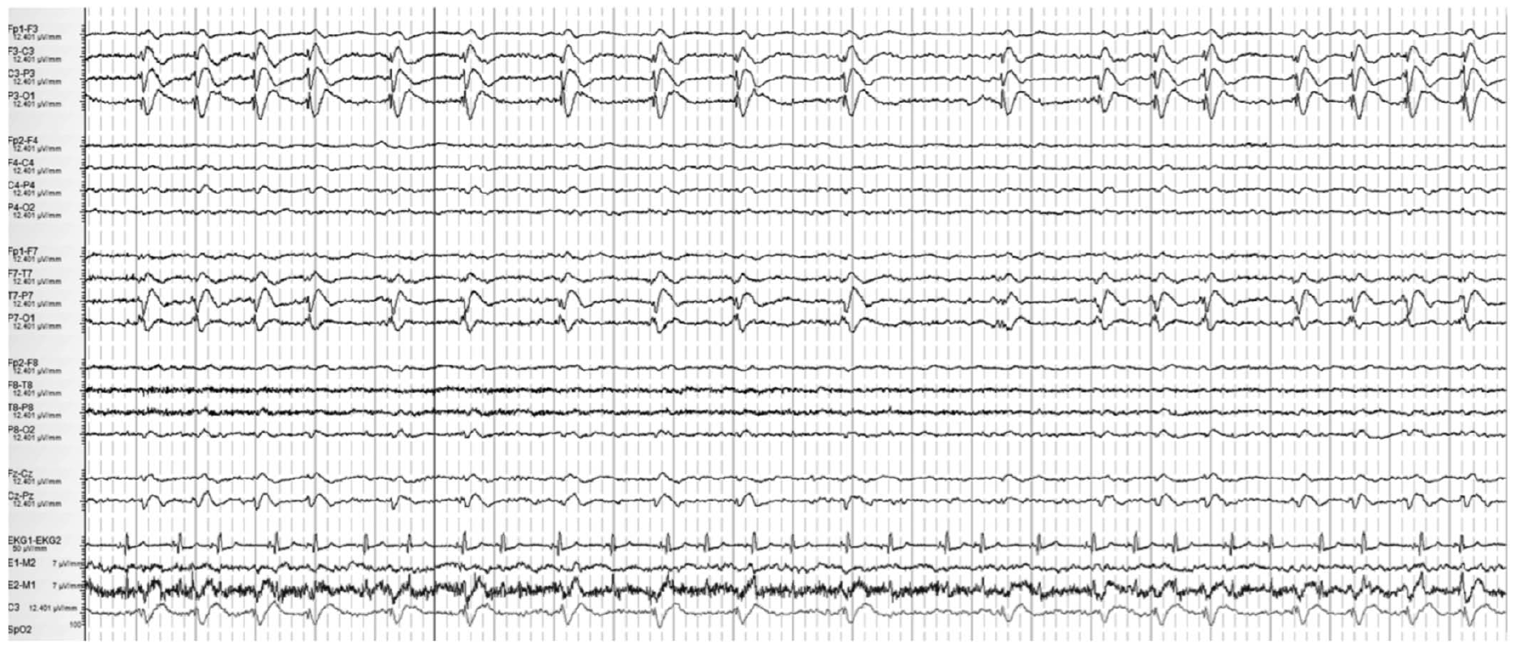
Please describe the pattern

Slide 111
<1 min
<1 min
1 Hz
0.5 Hz
1 Hz
1st change (1 Hz to 0.5 Hz)
2nd change (0.5 Hz to 1 Hz)
Lateralized Periodic Discharges, fluctuating. This EEG is shown on a compressed time scale to demonstrate LPDs slowing from 1 Hz to 0.5 Hz for <1 minute (1st change) and then accelerating back to 1 Hz (2nd change). This patient had fluctuating LPDs but in order to qualify as fluctuation there would have to be at least 3 changes not more than 1 min apart (3rd change not shown).

Slide 112
FLUCTUATION in LOCATION
>3 changes, not more than one minute apart, in location (by at least 1 standard inter-electrode distance), but not qualifying as evolving. This includes patterns spreading in and out of a single electrode repeatedly.
In order to qualify as present, a single location must persist at least 3 cycles.

Slide 113
FLUCTUATION in LOCATION

Slide 114
MAJOR MODIFIERS: STIMULUS INDUCED/ TERMINATED
Many patterns including seizures can be reproducibly brought about or exacerbated by an alerting stimulus, with or without clinical alerting, when a patient is in their less-stimulated state. The phenomenon was initially described as stimulus-induced rhythmic, periodic, or ictal appearing discharges (SIRPIDs). Since then, it has become evident that the content of the stimulus-induced pattern, rather than the fact that it is stimulus induced or not, carries the majority of significance. It is therefore encouraged to apply the term stimulus induced (SI-) or stimulus terminated (ST-) to the respective RPPs or seizures, as opposed to referring to them as a collective.
Patterns can be classified as:
Stimulus induced (SI-)
Stimulus terminated (ST-)
Spontaneous
Unknown, including unclear and untested

Slide 115
Describe the EEG changes following stimulation with sternal rub at the time of the red bar

Slide 116
Stimulus Induced Generalized Periodic Discharges, SI-GPD
(0.5 Hz)

Slide 117
SIRPIDs: example 2B
Please classify the EEG; intranasal tickle was performed in the middle of part A
Reproduced with permission from Hirsch LJ, et al. Epilepsia 2008

Slide 118
SIRPIDs: example 2B
Reproduced with permission from Hirsch LJ, et al. Epilepsia. 2008
Stimulus-Induced Seizure (electroclinical sz.), SI-Seizure: STIM in part A (first arrow) leads to gradual development of a bilateral evolving ictal pattern, bitemporal maximum, over the next 30 secs (B-D), evolution in frequency: 10 hz→ 7 Hz → 4 Hz [end of sz not shown]; clinical correlate: mouth tightened, then finger twitching in left hand only, then eyes opened wide and deviated up and to the right. Recurred whenever stimulated.

Slide 119
D. Electrographic and Electroclinical Seizures

Slide 120
ELECTROGRAPHIC AND ELECTROCLINICAL SEIZURES

Slide 121
CLINICAL SUSPICION of nonconvulsive status epilepticus, NCSE
(without preexisting epileptic encephalopathy)
VIDEO/EEG
Electrographic
seizure ESz/ESE*
OR
Definite clinical correlate time-locked to pattern of any duration
OR
EEG AND clinical improvement with
IV ASM
OR
Ictal Interictal Continuum, IIC,
synonym: Possible Electrographic SE, poss. ESz/ESE*
IV-ASM trial
Electroclinical
seizure, ECSz/ECSE*
Yes
EEG AND CLINICAL improvement?
No
Possible Electroclinical SE, poss. ECSz/ECSE*
EEG + CLINICAL CONTEXT
EEG + CLINICAL CONTEXT
Clinical diagnosis of NCSE
Clinical diagnosis of Possible NCSE
* Status epilepticus if ≥10 continuous minutes OR ≥ 20% of any hour; seizure if neither is true
IV-ASM Intravenous Anti-Seizure Medication; PD Periodic Discharge;
RDA Rhythmic Delta Activity; SW Spike-and-wave or sharp-and-wave
Modified from Trinka & Leitinger,
2022, submitted

Slide 122
CLINICAL SUSPICION of nonconvulsive status epilepticus, NCSE
(without preexisting epileptic encephalopathy)
VIDEO/EEG
Epileptiform discharges averaging
> 2.5Hz
(>25 in 10 s)
Any pattern with definite evolution OF:
(and lasting $≥10 s)$
Definite clinical correlate time-locked to pattern of any duration
EEG AND clinical improvement with parenteral (typically IV) ASM
Any PD or SW that averages...
OR
Any lateralized RDA averaging...
OR
OR
OR
OR
>1.0Hz but
$≤$ 2.5Hz
over 10s
$≥$0.5Hz but
$≤$ 1.0Hz
over 10s WITH:
OR
>1Hz for $≥$10s
WITH:
OR
OR
OR
OR
FREQUENCY
MORPHOLOGY
LOCATION
PLUS modifier
FLUCTUATION
PLUS modifier
FLUCTUATION
Electrographic
seizure ESz/ESE*
OR
Electroclinical
seizure, ECSz/ECSE*
OR
Ictal Interictal Continuum, IIC,
synonym: Possible Electrographic Sz/SE, poss. ESz/ESE*
IV-ASM trial
Yes
EEG AND CLINICAL improvement?
No
Possible Electroclinical SE, poss. ECSz/ECSE*
EEG + CLINICAL CONTEXT
EEG + CLINICAL CONTEXT
Clinical diagnosis of NCSE
Clinical diagnosis of Possible NCSE
* Status epilepticus if ≥10 continuous minutes OR ≥ 20% of any hour; seizure if neither is true
IV-ASM Intravenous Anti-Seizure Medication; PD Periodic Discharge;
RDA Rhythmic Delta Activity; SW Spike-and-wave or sharp-and-wave
Modified from Trinka & Leitinger,
2022, submitted

Slide 123
Electrographic and Electroclinical Seizures

Slide 124
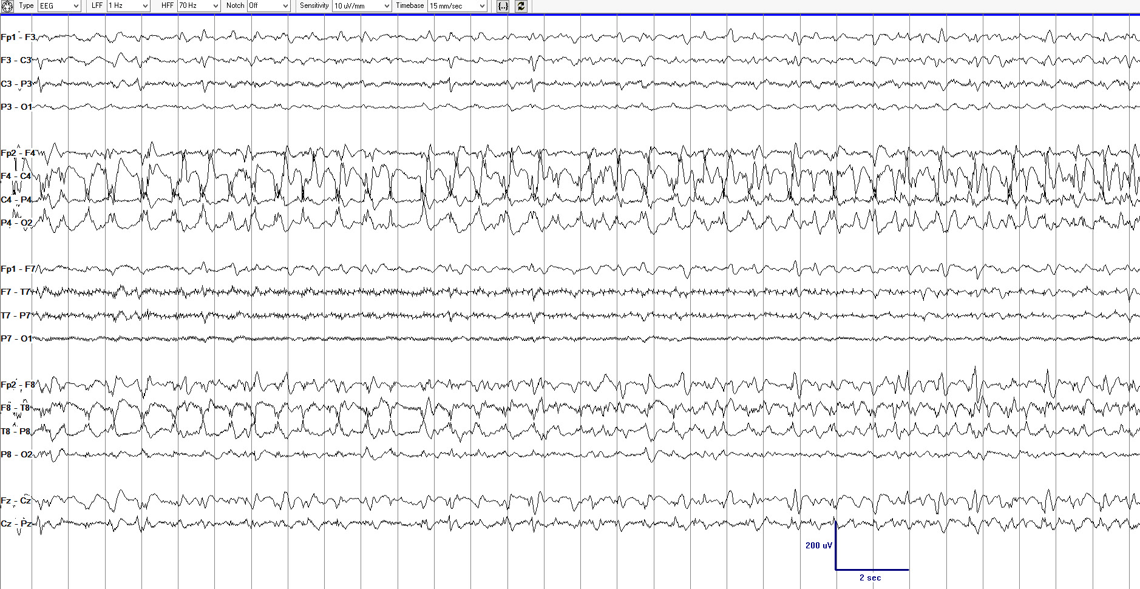
How would you best describe the 3 pages of EEG (compressed time scale), page 1 of 3.
Reproduced with permission from Hirsch LJ, Fong MWK, Brenner RP. Atlas of EEG in Critical Care, second edition, Wiley: 2022

Slide 125
How would you best describe the 3 pages of EEG (compressed time scale), page 2 of 3.
Reproduced with permission from Hirsch LJ, Fong MWK, Brenner RP. Atlas of EEG in Critical Care, second edition, Wiley: 2022

Slide 126
How would you best describe the 3 pages of EEG (compressed time scale), page 3 of 3.
Reproduced with permission from Hirsch LJ, Fong MWK, Brenner RP. Atlas of EEG in Critical Care, second edition, Wiley: 2022

Slide 127
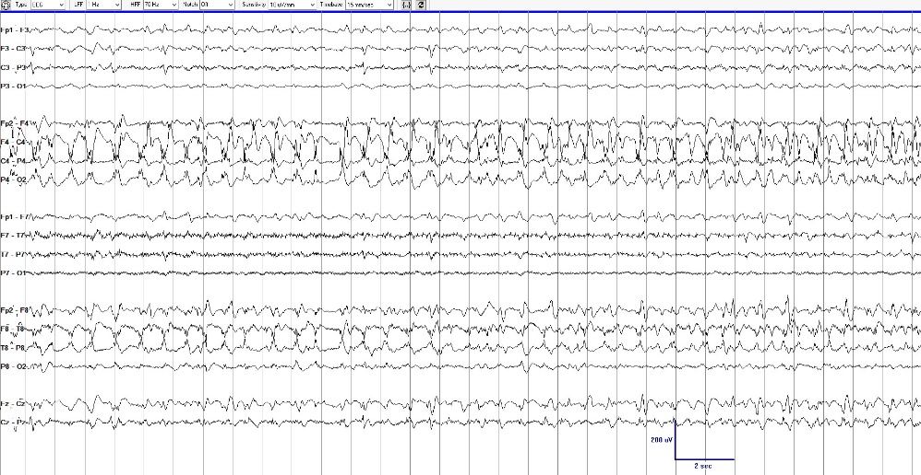
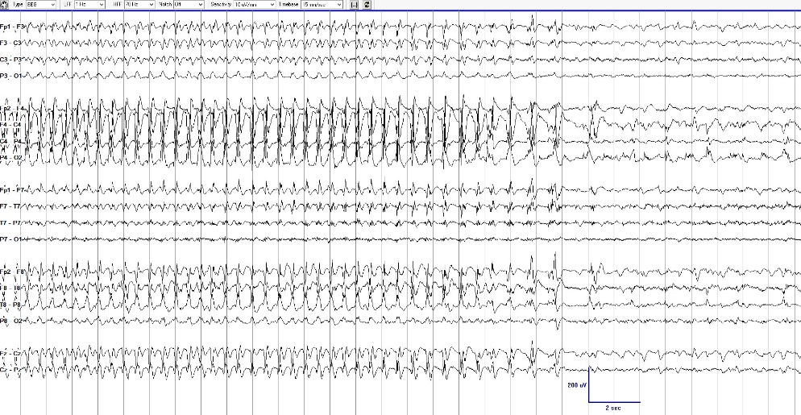
Page 1
Page 2
Page 3
Electrographic seizure (ESz) with clear evolution in frequency, morphology, and location lasting ≥10 seconds.
NOTE: If this pattern continued for 10 continuous minutes, OR if seizures comprised ≥20% (i.e., ≥12 minutes) of any given hour, this would also qualify as electrographic status epilepticus (ESE).

Slide 128
Electroclinical Seizures

Slide 129
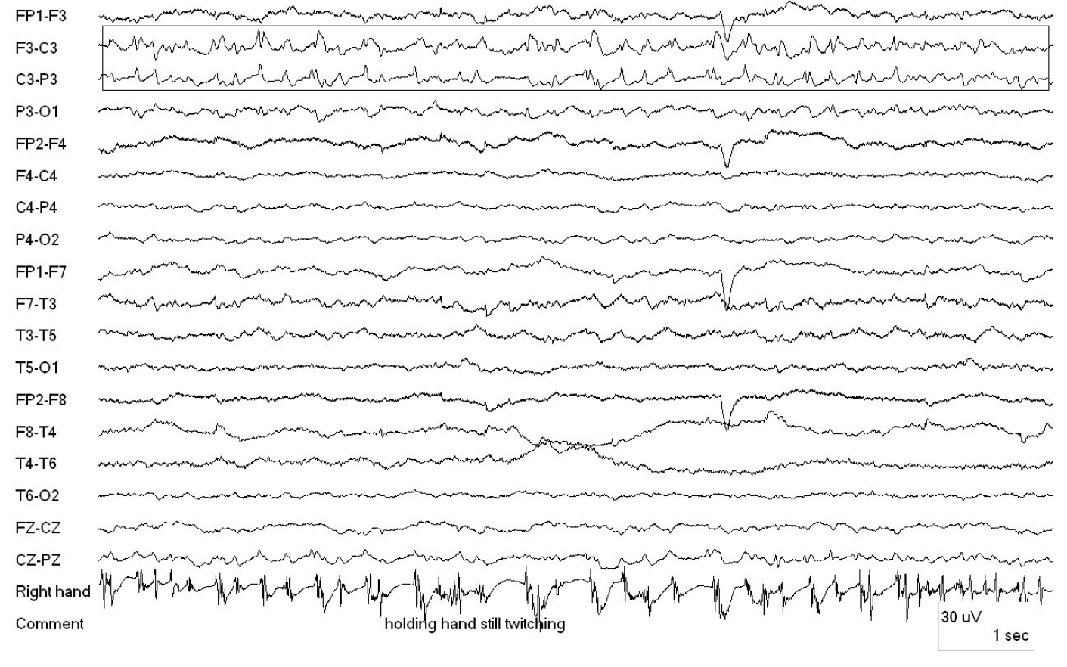
What is the correct term for this pattern?
Reproduced with permission from Hirsch LJ, Fong MWK, Brenner RP. Atlas of EEG in Critical Care, second edition, Wiley: 2022

Slide 130
Lateralized Periodic Discharges time locked with contralateral motor semiology (see bottom channel); thus, this is an Electroclinical seizure or Electroclinical status epilepticus (depending on time criterion)
Reproduced with permission from Hirsch LJ, Fong MWK, Brenner RP. Atlas of EEG in Critical Care, second edition, Wiley: 2022

Slide 131
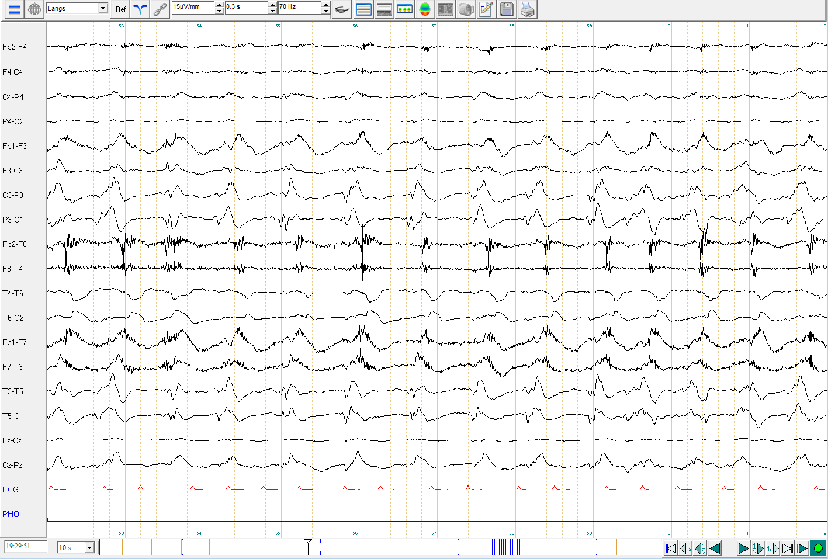
89 y.o. woman found confused with minor movements of extremities and later in face.
Please describe the pattern

Slide 132
Periodic Discharges
Muscle artifacts due to time-locked jerks
Lateralized Periodic Discharges time locked with contralateral motor semiology; thus, this is an Electroclinical seizure or Electroclinical status epilepticus (depending on time criterion)

Slide 133
E. Brief potentially Ictal Rhythmic Discharges (BIRDs)

Slide 134
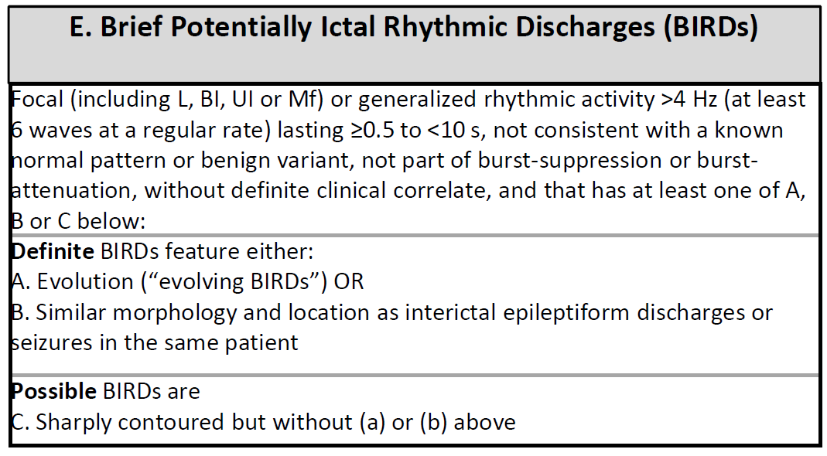
BRIEF POTENTIALLY ICTAL RHYTHMIC DISCHARGES (BIRDs)

Slide 135
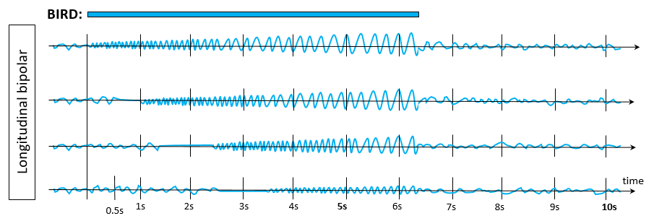
BRIEF POTENTIALLY ICTAL RHYTHMIC DISCHARGES
Brief Potentially Ictal Rhythmic Discharges (BIRDs):
a. DEFINITE BIRDs: Evolution (“evolving BIRDs”).
OR…

Slide 136
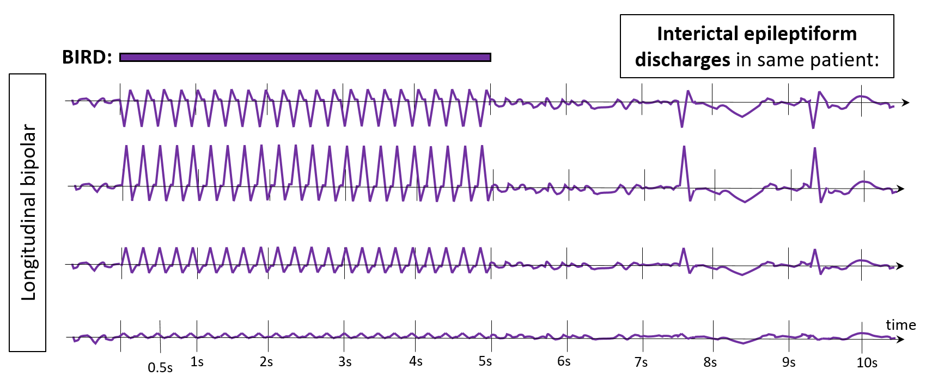
BRIEF POTENTIALLY ICTAL RHYTHMIC DISCHARGES
Brief Potentially Ictal Rhythmic Discharges (BIRDs):
b. DEFINITE BIRDs: Similar morphology and location as interictal epileptiform discharges in the same patient.

Slide 137
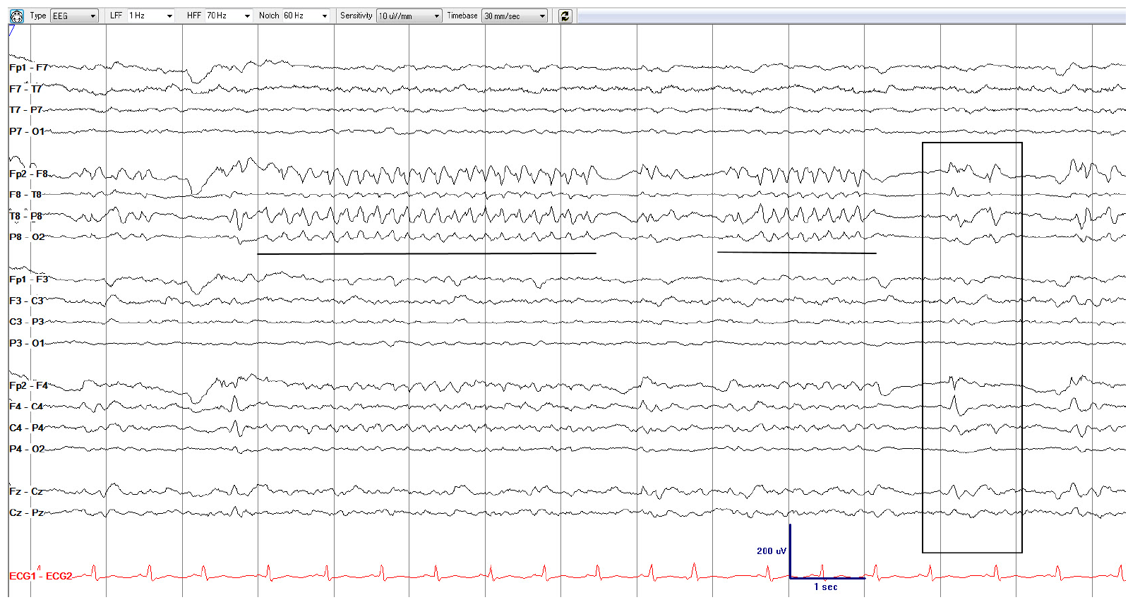
How would you describe the underlined patterns?

Slide 138
Brief Potentially Ictal Rhythmic Discharges, similar to sporadic epileptiform discharges = DEFINITE BIRDs
(Right anterior-mid temporal maximum, 5 Hz, sharply contoured, rhythmic activity, lasting 4.5 and 2 seconds (underlined). This activity has a similar location and morphology as the sporadic epileptiform discharges (box), making this a definite BIRD.

Slide 139
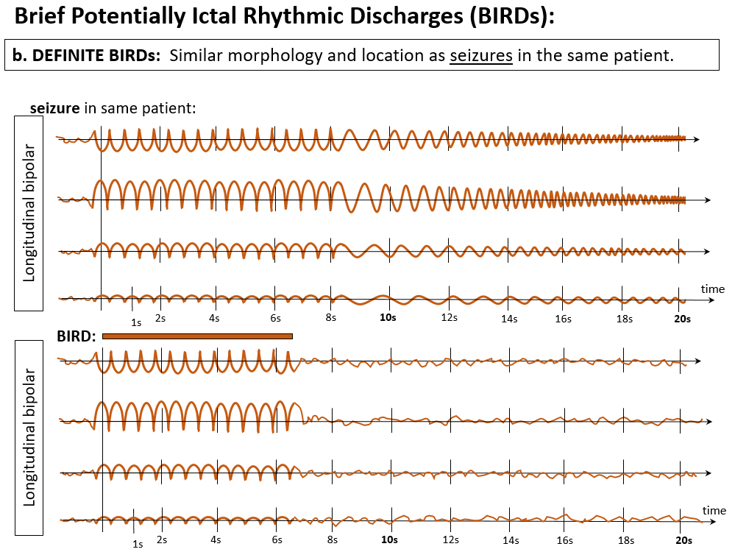
BRIEF POTENTIALLY ICTAL RHYTHMIC DISCHARGES
OR…

Slide 140
BRIEF POTENTIALLY ICTAL RHYTHMIC DISCHARGES

Slide 141
F. Ictal-Interictal Continuum (IIC)

Slide 142
ICTAL-INTERICTAL CONTINUUM (IIC)
This term is synonymous with “possible ESz” or “possible electrographic SE.” The IIC is a purely electrographic term that is not a diagnosis; it requires careful interpretation in the full clinical context. A pattern on the IIC is a pattern that does not qualify as an ESz or ESE, but there is a reasonable chance that it may be contributing to impaired alertness, causing other clinical symptoms, and/or contributing to neuronal injury. Thus, it is potentially ictal in at least some sense and often warrants a diagnostic treatment trial, typically with a parenteral antiseizure medication.
The following patterns can be considered to be on the ictal-interictal continuum (IIC):
A. Any PD or SW pattern that averages >1.0 Hz and <2.5 Hz over 10 s (>10 and <25 discharges in 10 s);
OR…

Slide 143
ICTAL-INTERICTAL CONTINUUM (IIC)
B. Any PD or SW pattern that averages ≥0.5 Hz and ≤1.0 Hz over 10 seconds (≥5 and ≤10 discharges in 10 s), AND has a plus modifier or fluctuation;
PLUS-MODIFIERs
OR…

Slide 144
ICTAL-INTERICTAL CONTINUUM (IIC)
B. Any PD or SW pattern that averages ≥0.5 Hz and ≤1.0 Hz over 10 seconds (≥5 and ≤10 discharges in 10 s), AND has a plus modifier or fluctuation;
FLUCTUATION
OR…

Slide 145
ICTAL-INTERICTAL CONTINUUM (IIC)
C. Any lateralized RDA (LRDA, BIRDA, UIRDA, MfRDA) averaging >1 Hz for ≥10 s (at least 10 waves in 10 s) with a plus modifier or fluctuation.
PLUS-MODIFIER
OR…

Slide 146
ICTAL-INTERICTAL CONTINUUM (IIC)
C. Any lateralized RDA (LRDA, BIRDA, UIRDA, MfRDA) averaging >1 Hz for ≥10 s (at least 10 waves in 10 s) with a plus modifier or fluctuation.
Fluctuation

Slide 147
What pattern is this?
Part 1 of 3

Slide 148
1 Hz
Generalized Periodic Discharges (GPDs), 1.0 Hz, no plus; not on IIC.
Part 1 of 3

Slide 149
How has the EEG changed compared to the prior page?
Part 2 of 3

Slide 150
1.5 Hz
1 Hz
1.5 Hz
Generalized Periodic discharges with fluctuating frequency: fluctuating GPDs (IIC)
(fluctuating between 1 Hz → 1.5 → 1 → 1.5 Hz: now qualifying as a pattern on the Ictal-Interictal-Continuum [IIC])
Part 2 of 3

Slide 151
Part 3 of 4
How has the EEG changed compared to the prior 2 pages?
Part 3 of 3

Slide 152
1.5 Hz
2 Hz
1.5 Hz
2 Hz
Rhythmic activity
GPDs with fluctuating frequency and rhythmic activity; fluctuating GPDs+R (IIC)
(1.5 Hz → 2 → 1.5 → 2 Hz, superimposed rhythmic delta activity → +R; Still not definitely ictal, but much closer than the prior page and the page before that; and much more likely to be contributing to symptoms/onging neuronal injury).
Part 3 of 3

Slide 153
END
Thank you for completing the ACNS Critical Care EEG Terminology Training Module

